Slide 1
Chapter 12 Object-Oriented Programming: Polymorphism
C++ How to Program, 9/e

Slide 2
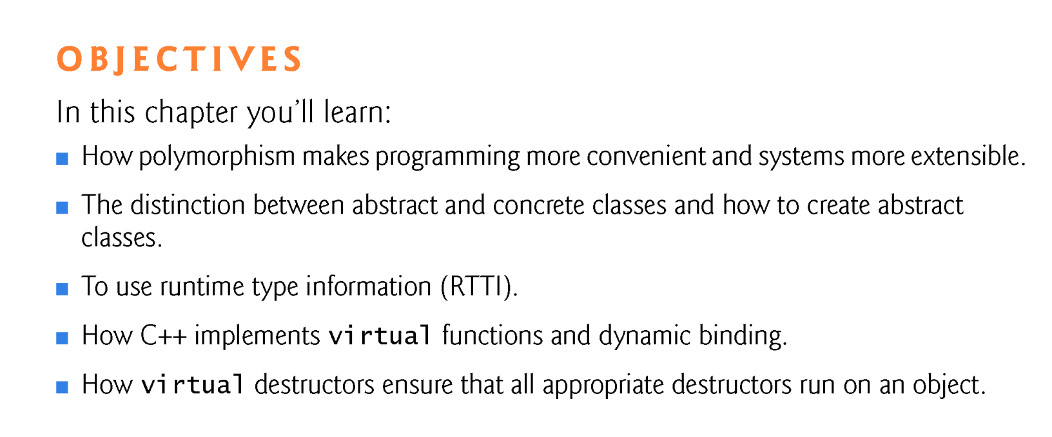
Concepts you must understand by the end of this chapter:
overriding versus redefining
overriding versus overloading
object handles: object name, pointer to object, reference to object
polymorphic behavior requires:
a base class reference/pointer to a derived class object
a base class function that is a virtual function
an inherited base class virtual function must be overridden in a derived class

Slide 3
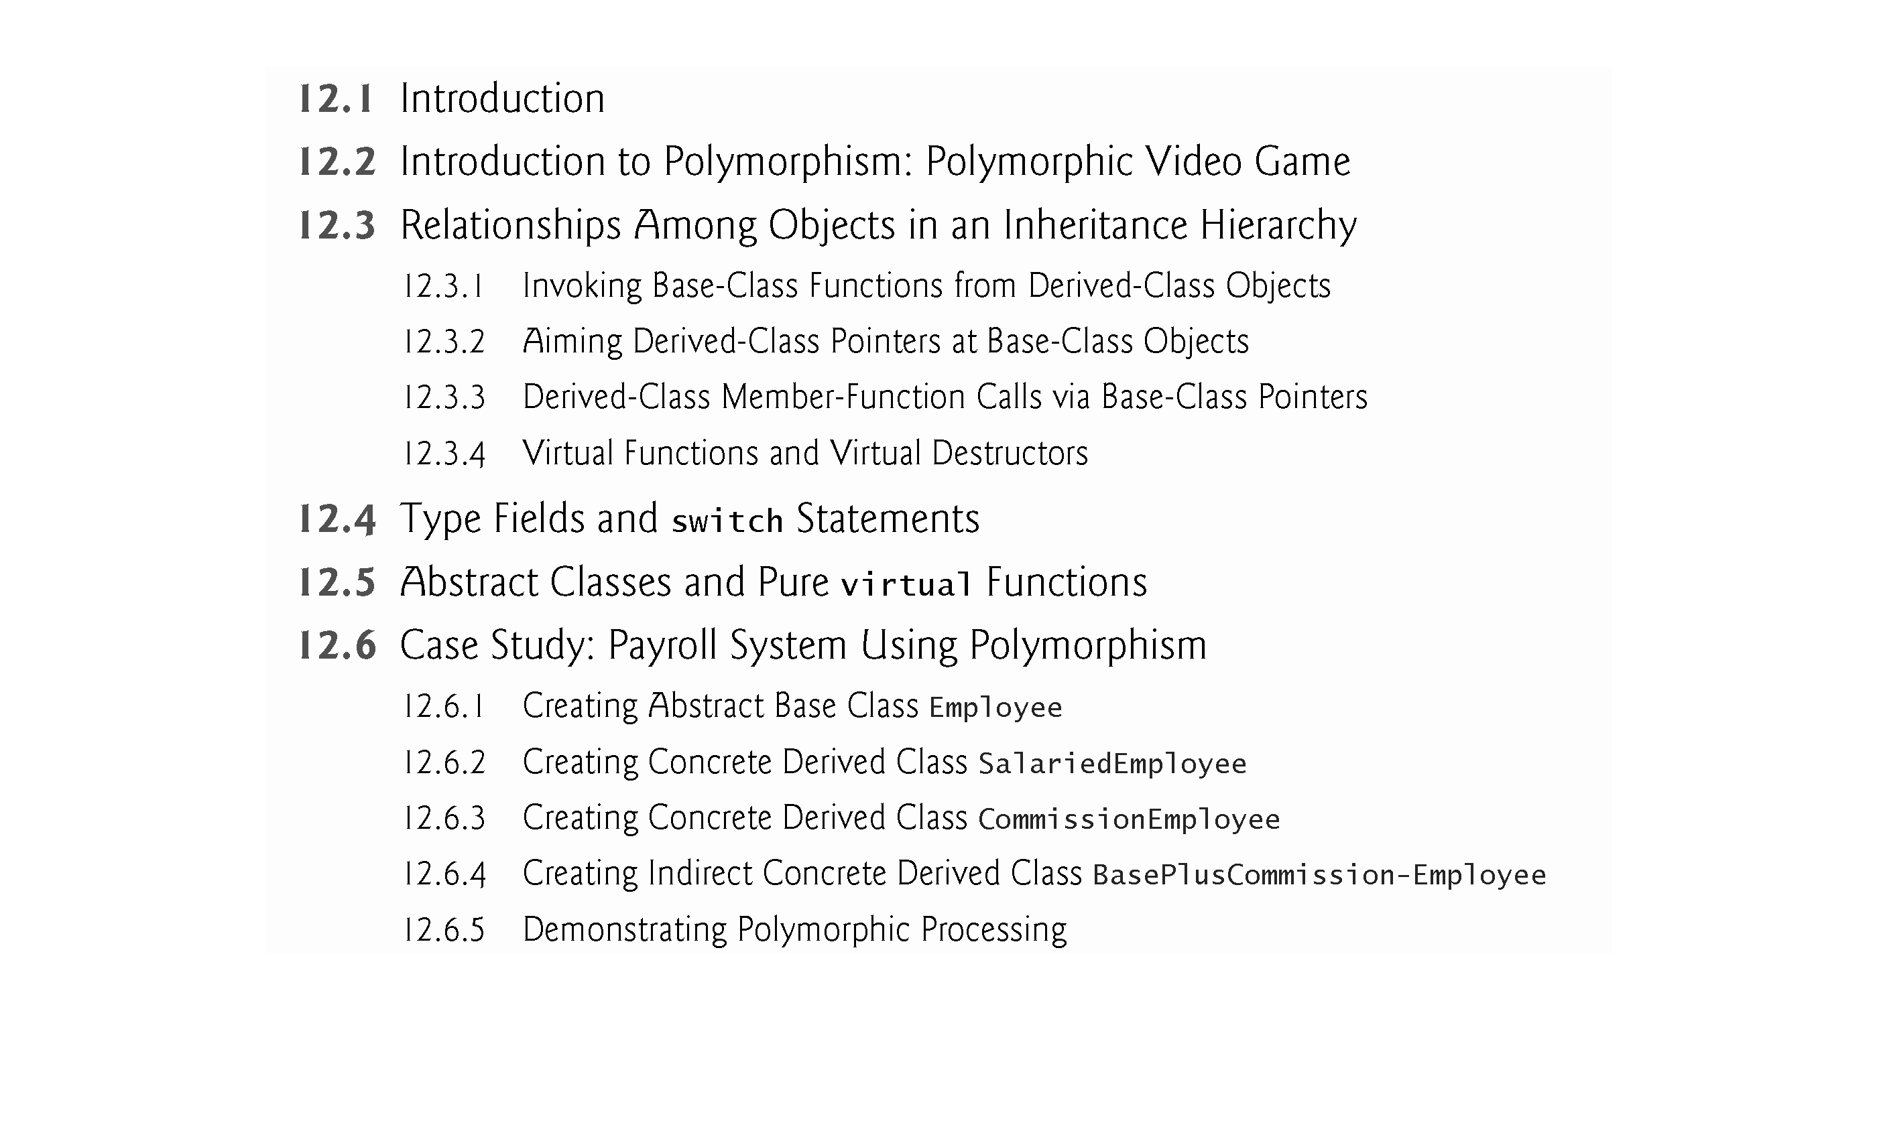

Slide 4
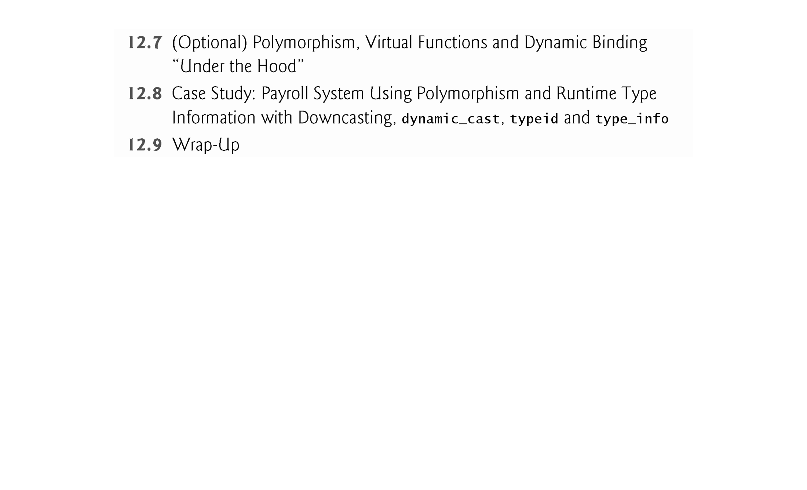

Slide 5
12.1 Introduction
Polymorphism enables us to “program in the general” rather than “program in the specific.”
Enables us to write programs that process objects of classes that are part of the same class hierarchy as if they were all objects of the hierarchy’s base class.
Polymorphism works off base-class pointer handles (*) and base-class reference handles (&), but not off name handles (object name).
Relying on each object to know how to “do the right thing” in response to the same function call is the key concept of polymorphism.
The same message sent to a variety of objects has “many forms” of results—hence the term polymorphism. [ speak( ), draw( ), earnings( ) ]

Slide 6
12.1 Introduction (cont.)
With polymorphism, we can design and implement systems that are easily extensible.
New classes can be added with little or no modification to the general portions of the program, as long as the new classes are part of the inheritance hierarchy that the program processes generally.
The only parts of a program that must be altered to accommodate new classes are those that require direct knowledge of the new classes that you add to the hierarchy.

Slide 7
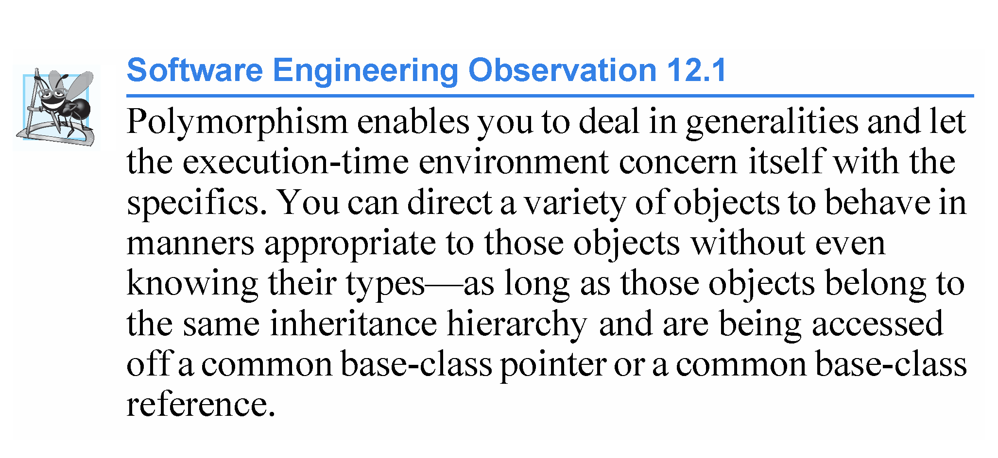
Polymorphism in C++ is only possible using (pointer variables or reference variables) and virtual functions.

Slide 8
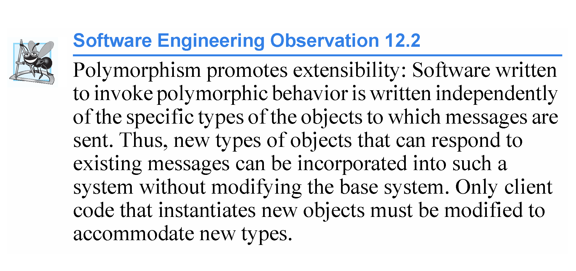

Slide 9
12.3 Relationships Among Objects in an Inheritance Hierarchy
The next several sections present a series of examples that demonstrate how base-class and derived-class pointers can be aimed at base-class and derived-class objects, and how those pointers can be used to invoke member functions that manipulate those objects.
A key concept in these examples is to demonstrate that an object of a derived class can be treated as an object of its base class. A derived-class object is-a base class object.
Despite the fact that the derived-class objects are of different types, the compiler allows this because each derived-class object is-a object of its base class.
However, we cannot treat a base-class object as an object of any of its derived classes. A base-class is-NOT-a derived-class.
The is-a relationship applies only from a derived class to its direct and indirect base classes. [ bottom to top of hierarchy ]

Slide 10
12.3.1 Invoking Base-Class Functions from Derived- Class Objects
The example in Fig. 12.1 reuses the final versions of classes CommissionEmployee and BasePlusCommissionEmployee from Section 11.3.5.
The first two are natural and straightforward—we aim a base-class pointer at a base-class object and invoke base-class functionality, and we aim a derived-class pointer at a derived-class object and invoke derived-class functionality.
Then, we demonstrate the relationship between derived classes and base classes (i.e., the is-a relationship of inheritance) by aiming a base-class pointer at a derived-class object and showing that the base-class functionality is indeed available in the derived-class object.

Slide 11
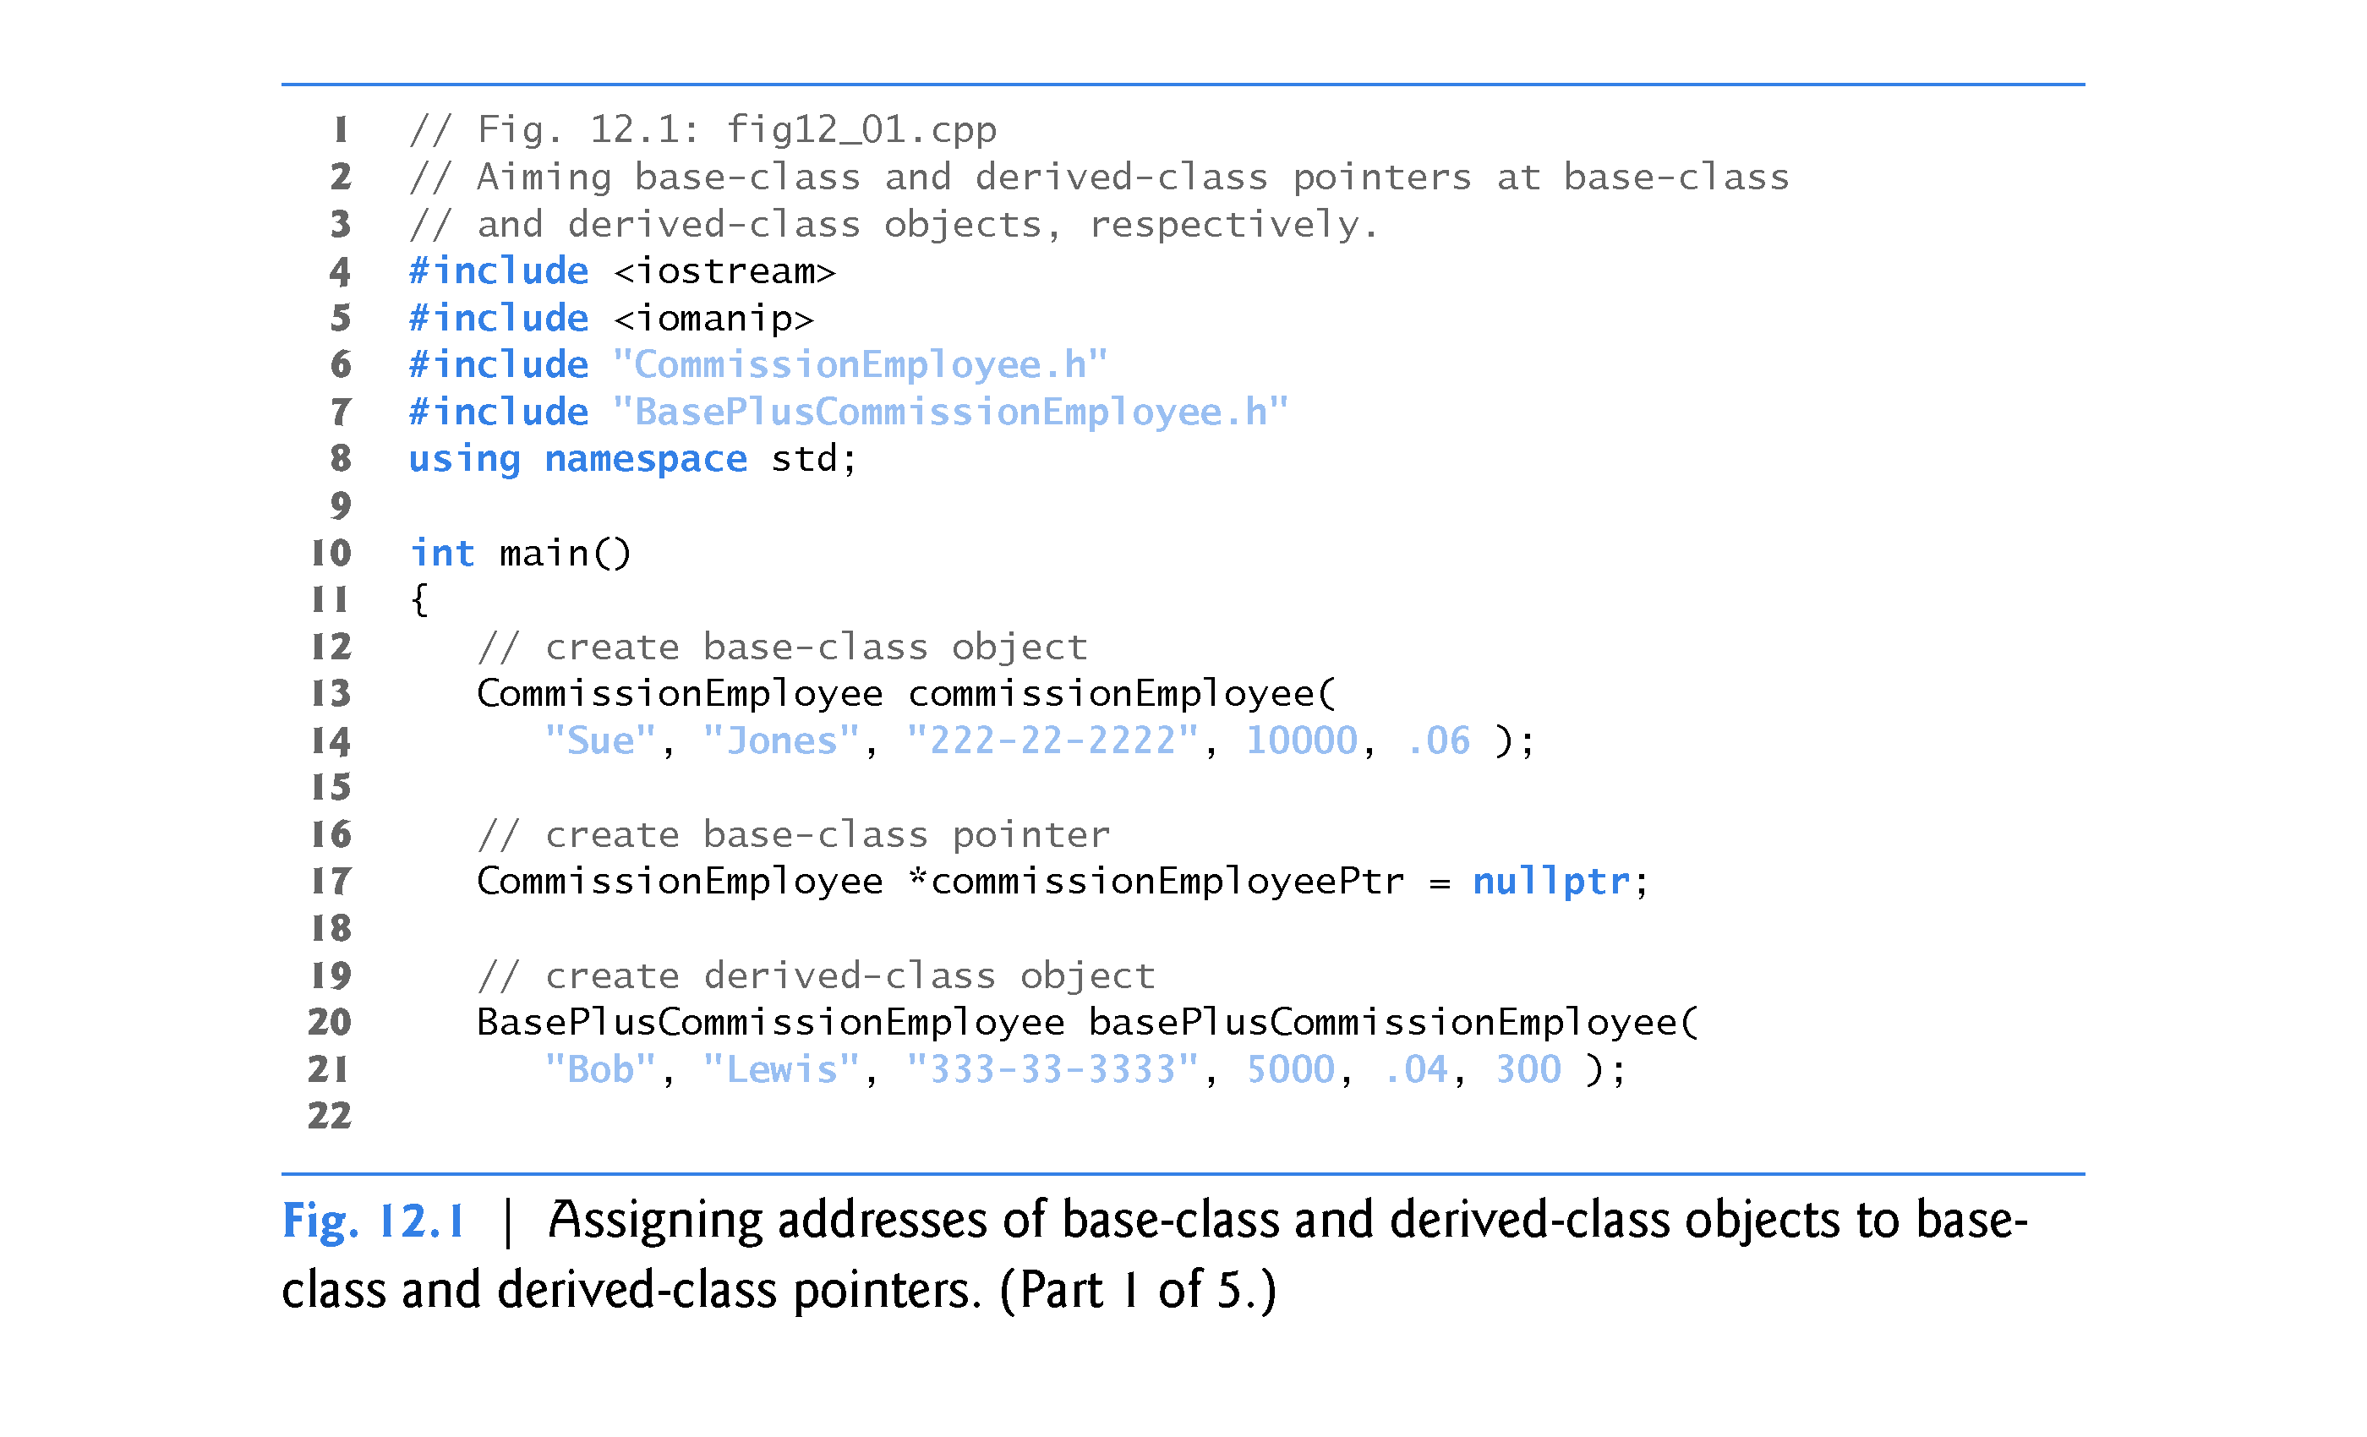

Slide 12
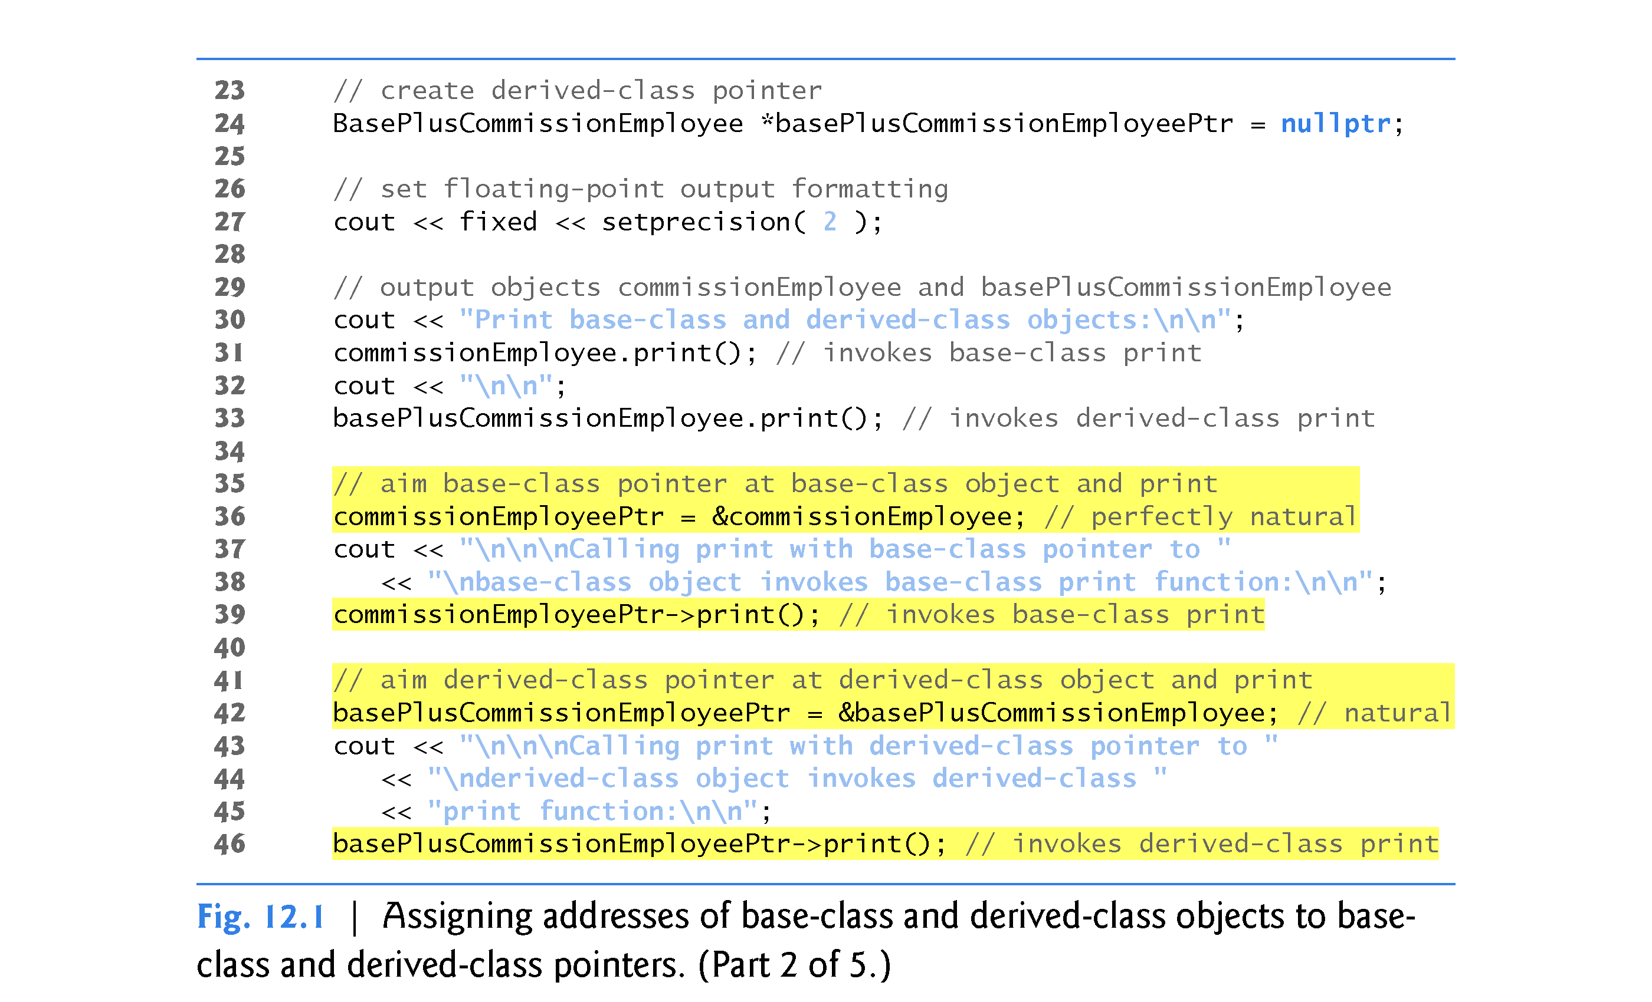

Slide 13
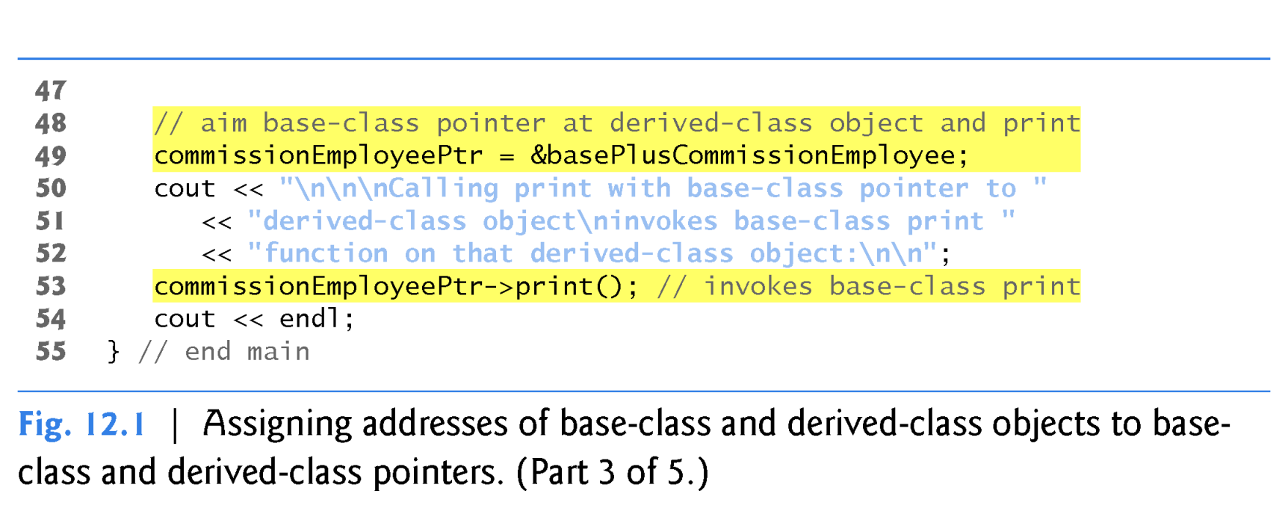
The CommissionEmployee print() function was “redefined” in class BasePlusCommissionEmployee.
We need the print() function in BasePlusCommissionEmployee to “override” the print() function inherited from CommissionEmployee so it can behave differently for a derived class object than it does for a base class object.
The print() function needs to be declared “virtual” in the base class CommissionEmployee to permit dynamic binding.
This will cause the function print to be overridden in the derived class rather than redefined.

Slide 14
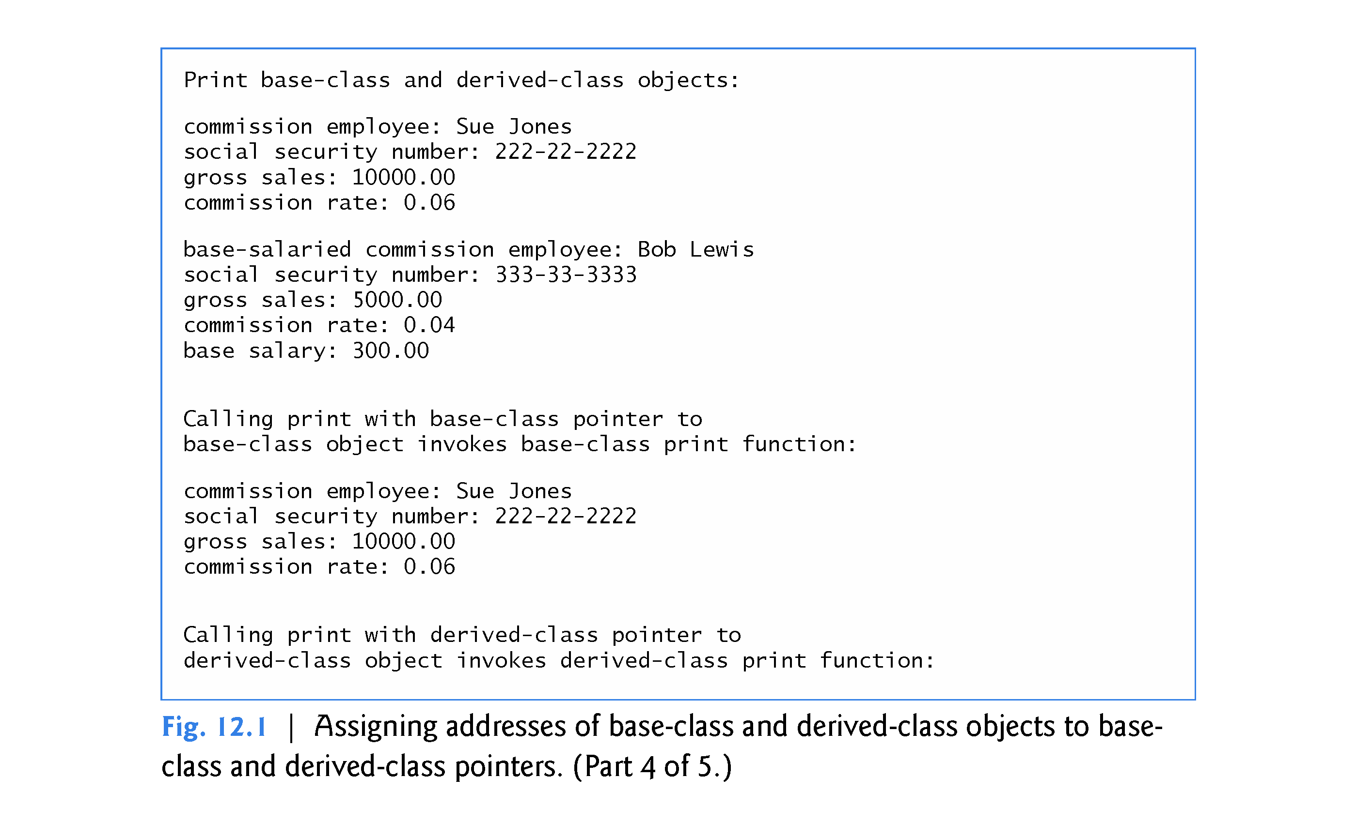

Slide 15
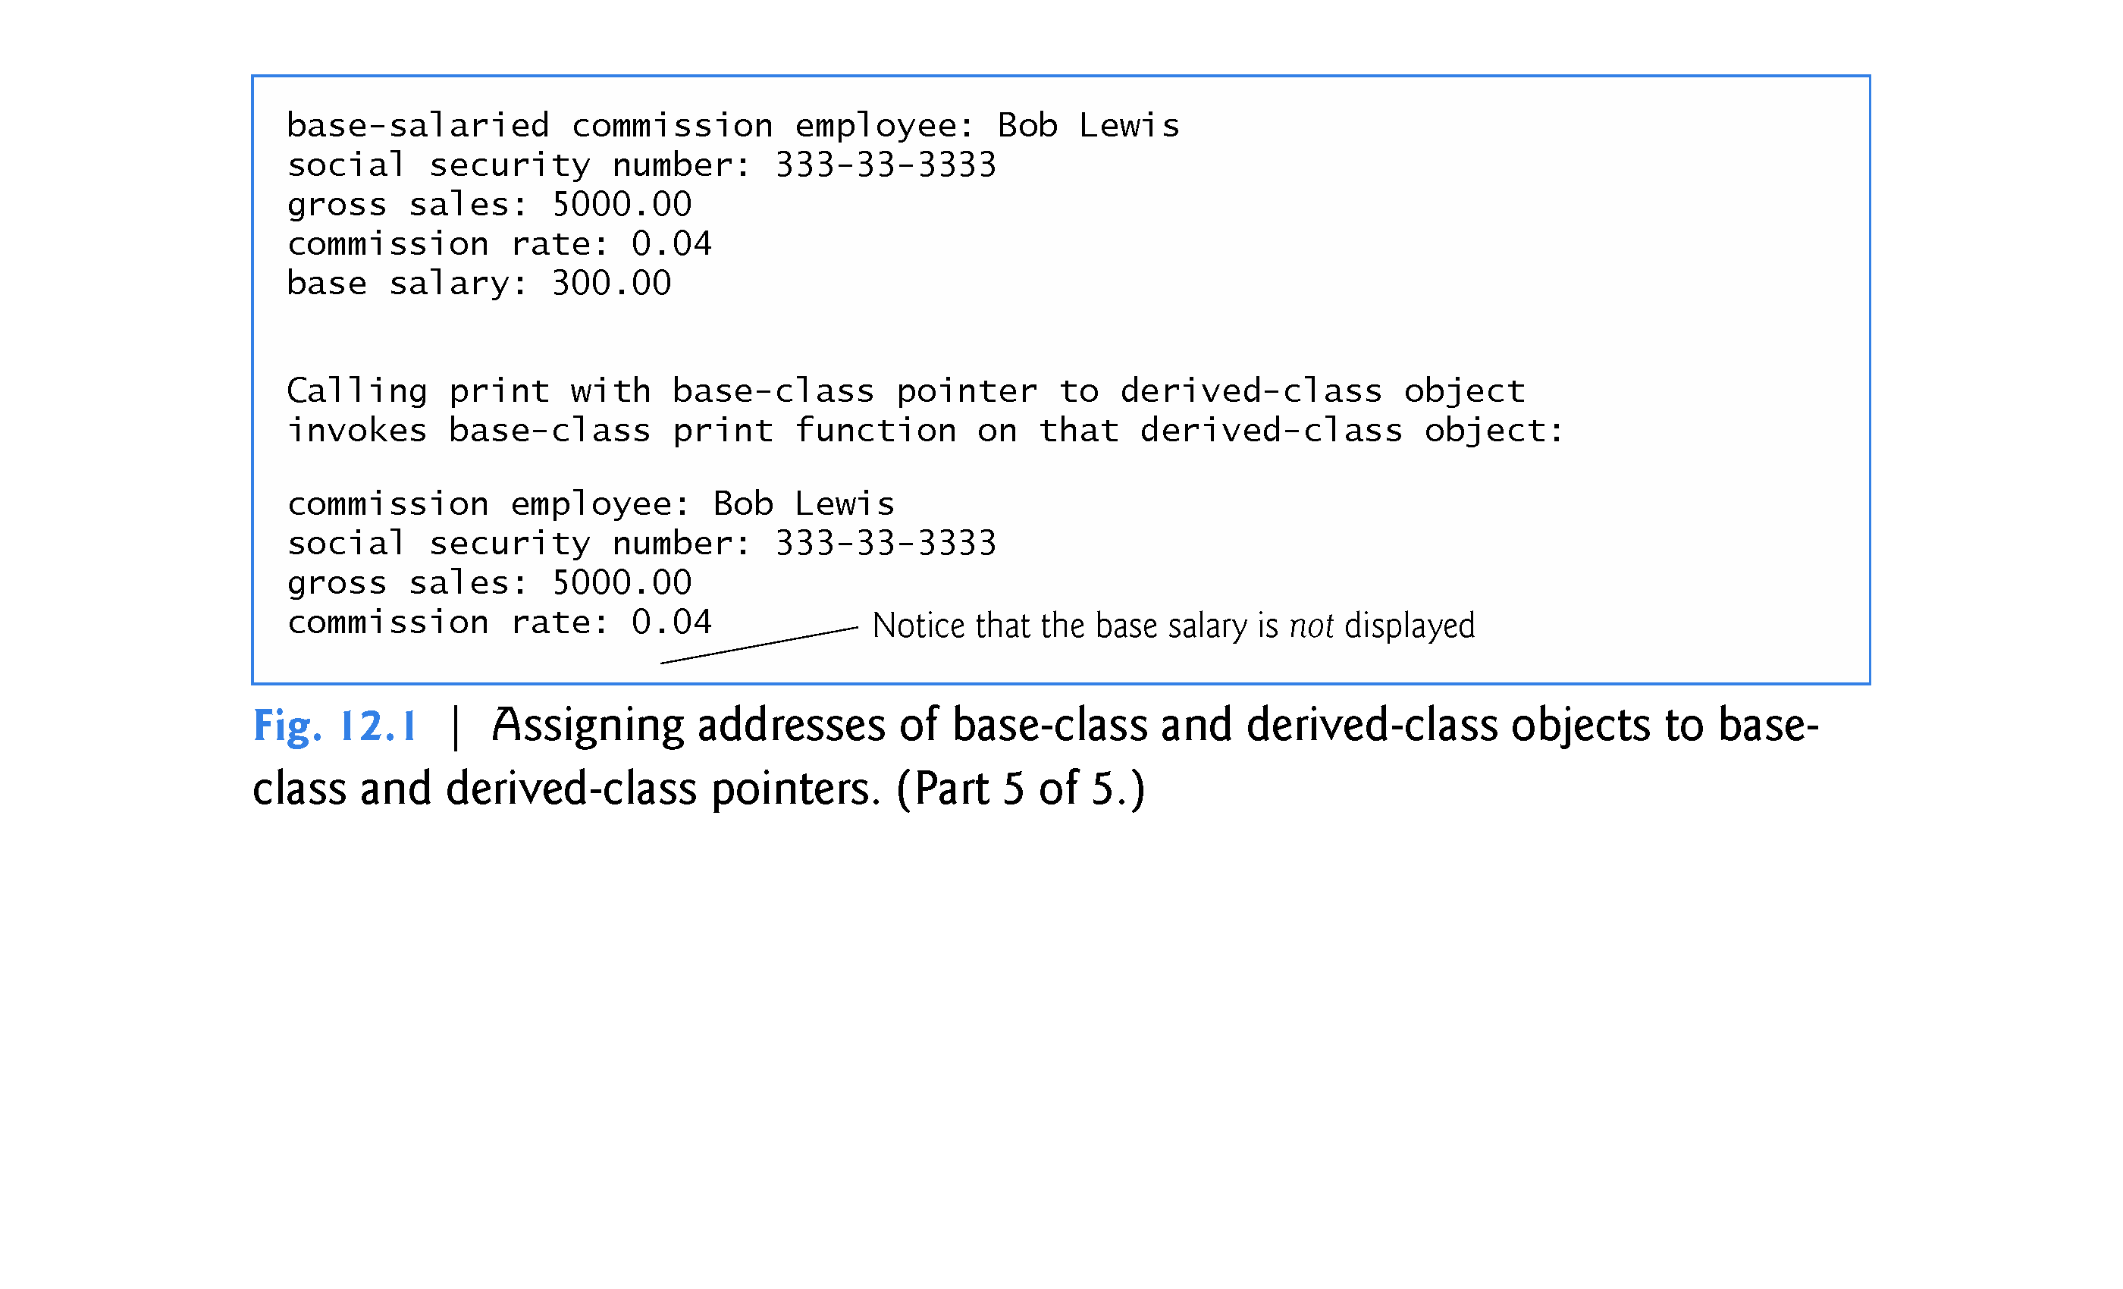

Slide 16
12.3.1 Invoking Base-Class Functions from Derived-Class Objects (cont.)
Aiming a Base-Class Pointer at a Base-Class Object
(apples to apples)
This invokes the version of print defined in base class CommissionEmployee.

Slide 17
12.3.1 Invoking Base-Class Functions from Derived-Class Objects (cont.)
Aiming a Derived-Class Pointer at a Derived-Class Object
(apples to apples)
This invokes the version of print defined in derived class BasePlusCommissionEmployee.
This would invoke the redefined print function in the derived class object.
This would have the same effect as creating an object and using the object name handle.

Slide 18
12.3.1 Invoking Base-Class Functions from Derived-Class Objects (cont.)
Aiming a Base-Class Pointer at a Derived-Class Object (Fig 12.1)
(apple to “Washington Apple”) [ No polymorphic behavior in this example ]
This “crossover” is allowed because an object of a derived class is-a object of its base class.
Note that despite the fact that the base class CommissionEmployee pointer points to a derived class BasePlusCommissionEmployee object, the base class CommissionEmployee’s print member function is invoked (rather than BasePlusCommissionEmployee’s print function) – i.e. no polymorphic behavior.
The behavior we need can be accomplished by declaring the base class print function to be a virtual function.

Slide 19
12.3.2 Aiming Derived-Class Pointers at Base-Class Objects
In Fig. 12.2 (next slide), we aim a derived-class pointer at a base-class object.
The compiler prevents this assignment, because a CommissionEmployee is NOT a BasePlusCommissionEmployee.

Slide 20
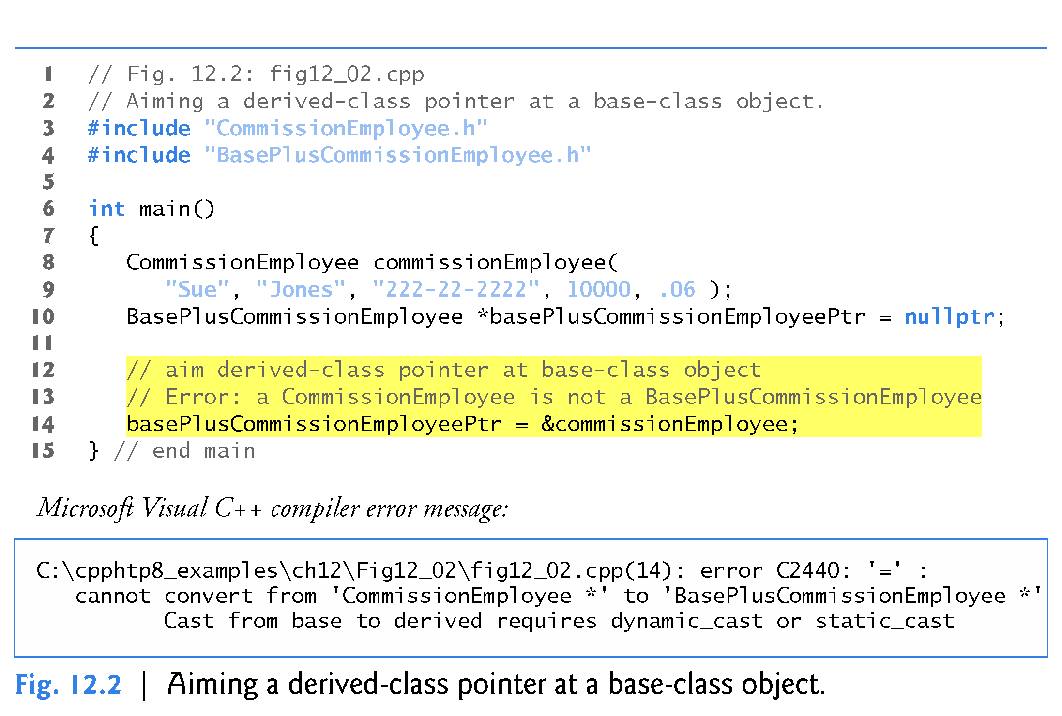

Slide 21
12.3.3 Derived-Class Member-Function Calls via Base-Class Pointers
Off a base-class pointer, the compiler allows us to invoke only base-class member functions.
If a base-class pointer is aimed at a derived-class object, and an attempt is made to access a derived-class-only member function, a compilation error will occur.
Figure 12.3 (next slide) shows the consequences of attempting to invoke a derived-class member function off a base-class pointer.

Slide 22
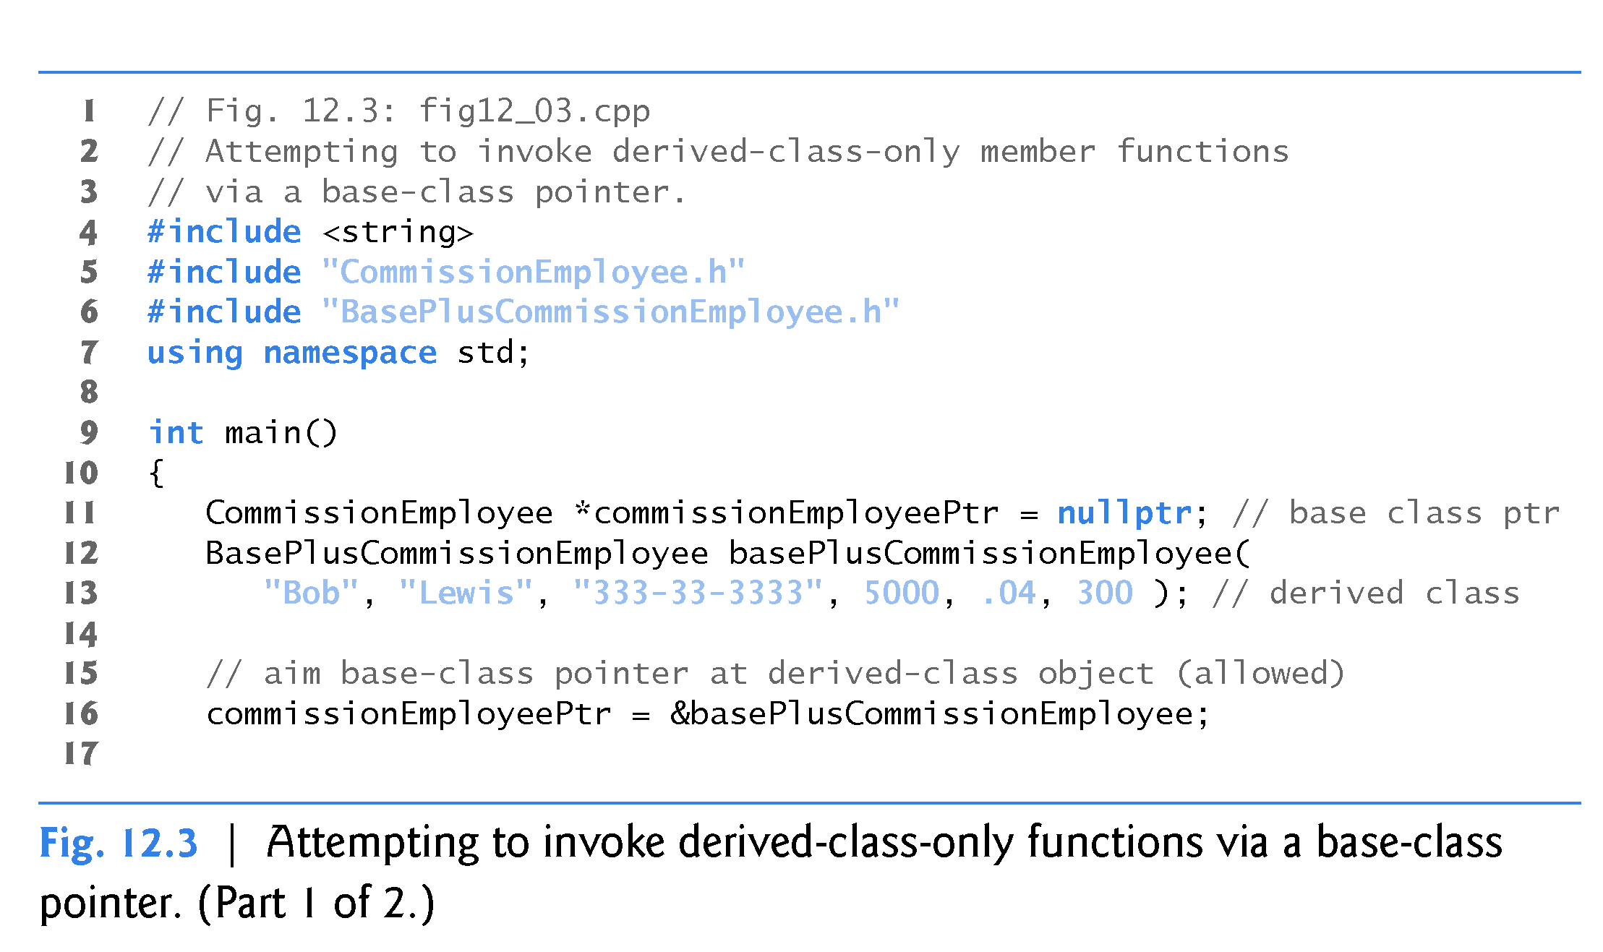

Slide 23
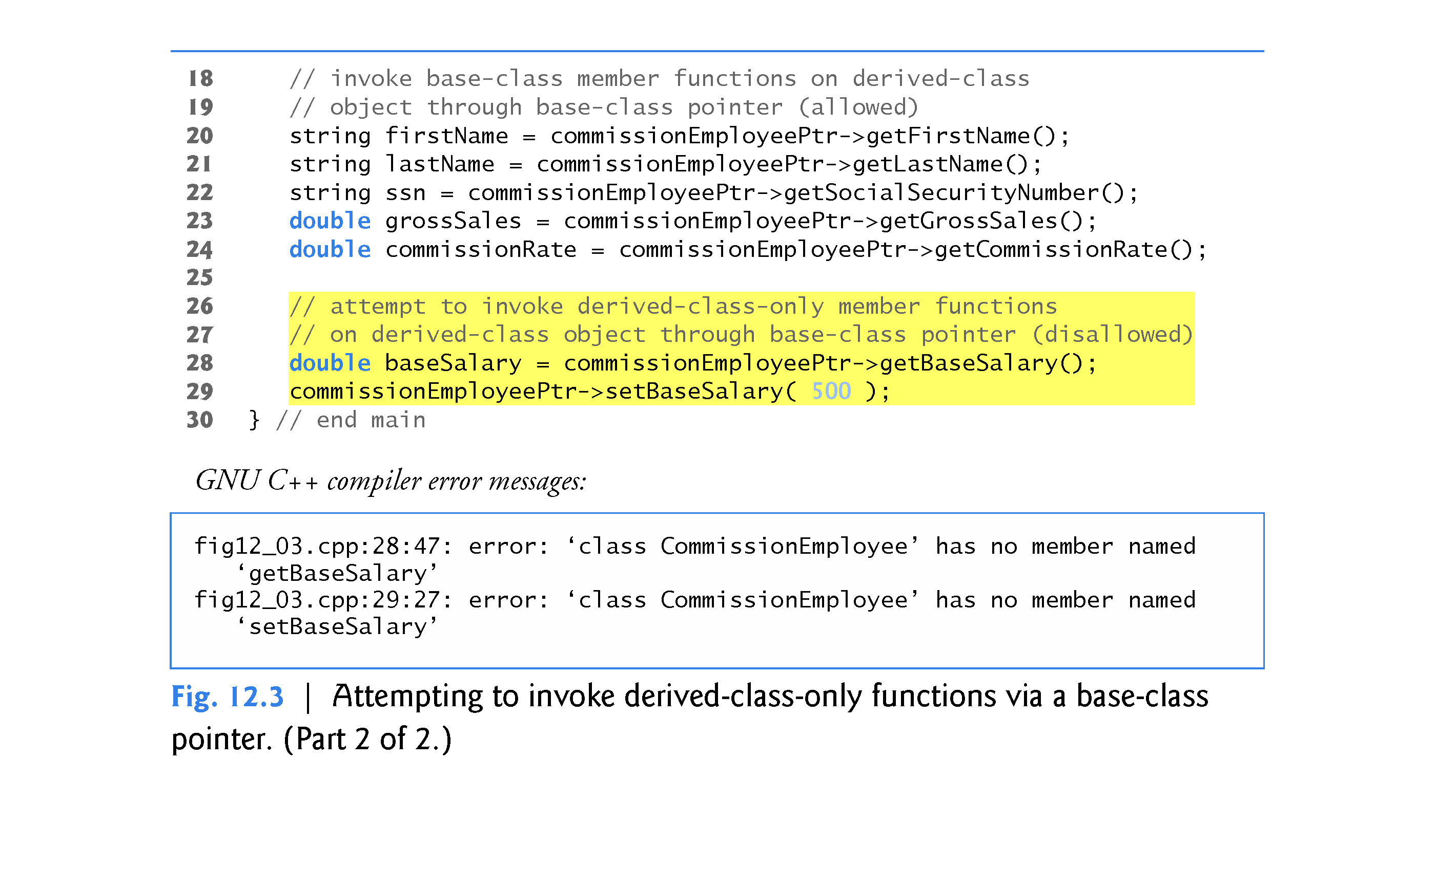

Slide 24
Class Hierarchy A <– AB <- ABC
A
base-class fields / functions
A
AB
base-class fields / functions
derived-class fields / functions
AB
ABC
base-class fields / functions
base-class fields / functions
derived-class fields / functions
ABC

Slide 25
12.3.3 Derived-Class Member-Function Calls via Base-Class Pointers (cont.)
Downcasting
A base-class pointer/reference CAN NOT be used to access a non base-class function (function introduced in a derived class).
To call a derived-class function (not in the base class) you must explicitly cast the base-class pointer to a derived-class pointer—this process is known as downcasting.
Downcasting allows a derived-class-specific operation on a derived-class object pointed to by a base-class pointer.
After a downcast, the program can invoke derived-class functions that are not in the base class.
Section 12.8 demonstrates how to safely use downcasting.

Slide 26
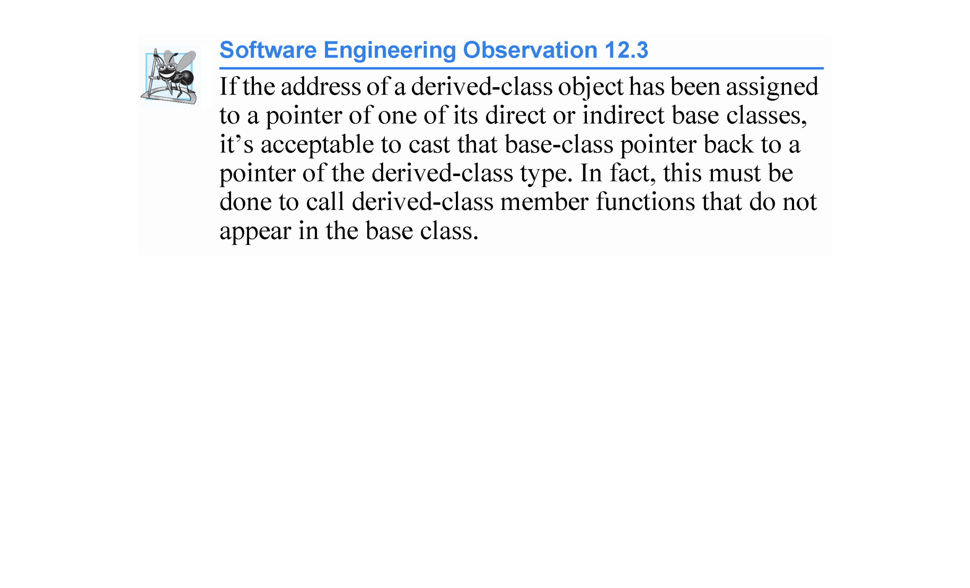

Slide 27
12.3.4 Virtual Functions and Virtual Destructors
Why virtual Functions Are Useful
Consider why virtual functions are useful: Suppose that shape classes such as Circle, Triangle, Rectangle and Square are all derived from base class Shape.
Each of these classes might be endowed with the ability to draw itself via a member function draw, but the function for each shape is quite different.
In a program that draws a set of shapes, it would be useful to be able to treat all the shapes generally as objects of the base class Shape.
To draw any shape, we could simply use a base-class Shape pointer to invoke function draw and let the program determine dynamically (i.e., at runtime) which derived-class draw function to use, based on the type of the object to which the base-class Shape pointer points at any given time.
This is polymorphic behavior. Base-class pointer/reference to derived-class object such that the modified version of the inherited function is invoked.

Slide 28
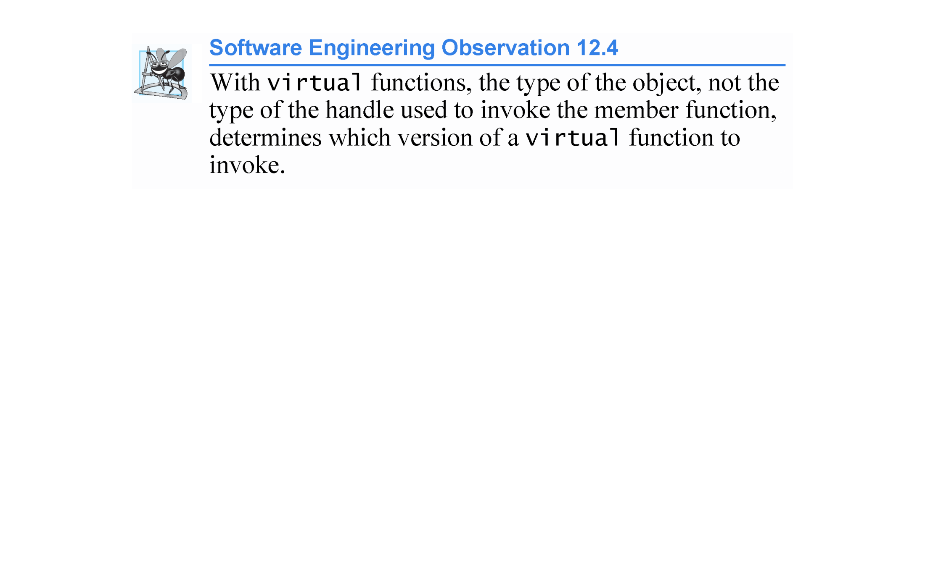
In C++ polymorphism is only possible using pointer/reference handles to objects with virtual functions.
Without virtual functions polymorphism is not possible.
Only virtual functions will exhibit polymorphic behavior.

Slide 29
12.3.4 Virtual Functions and Virtual Destructors
Declaring virtual Functions:
To enable this behavior, we declare draw in the base class as a virtual function, and we override draw in each of the derived classes to draw the appropriate shape.
From an implementation perspective, overriding a function is no different than redefining one.
An overridden function in a derived class has the same signature and return type (i.e., prototype) as the function it overrides in its base class.
If we declare the base-class function as virtual, we can override that function to enable polymorphic behavior.
We declare a virtual function by preceding the function’s prototype with the keyword virtual in the base class.

Slide 30
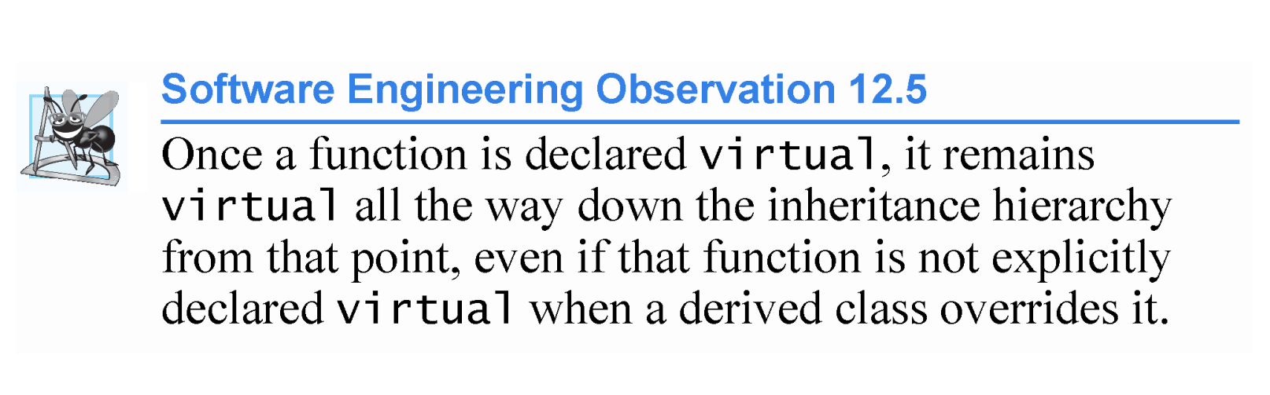

Slide 31
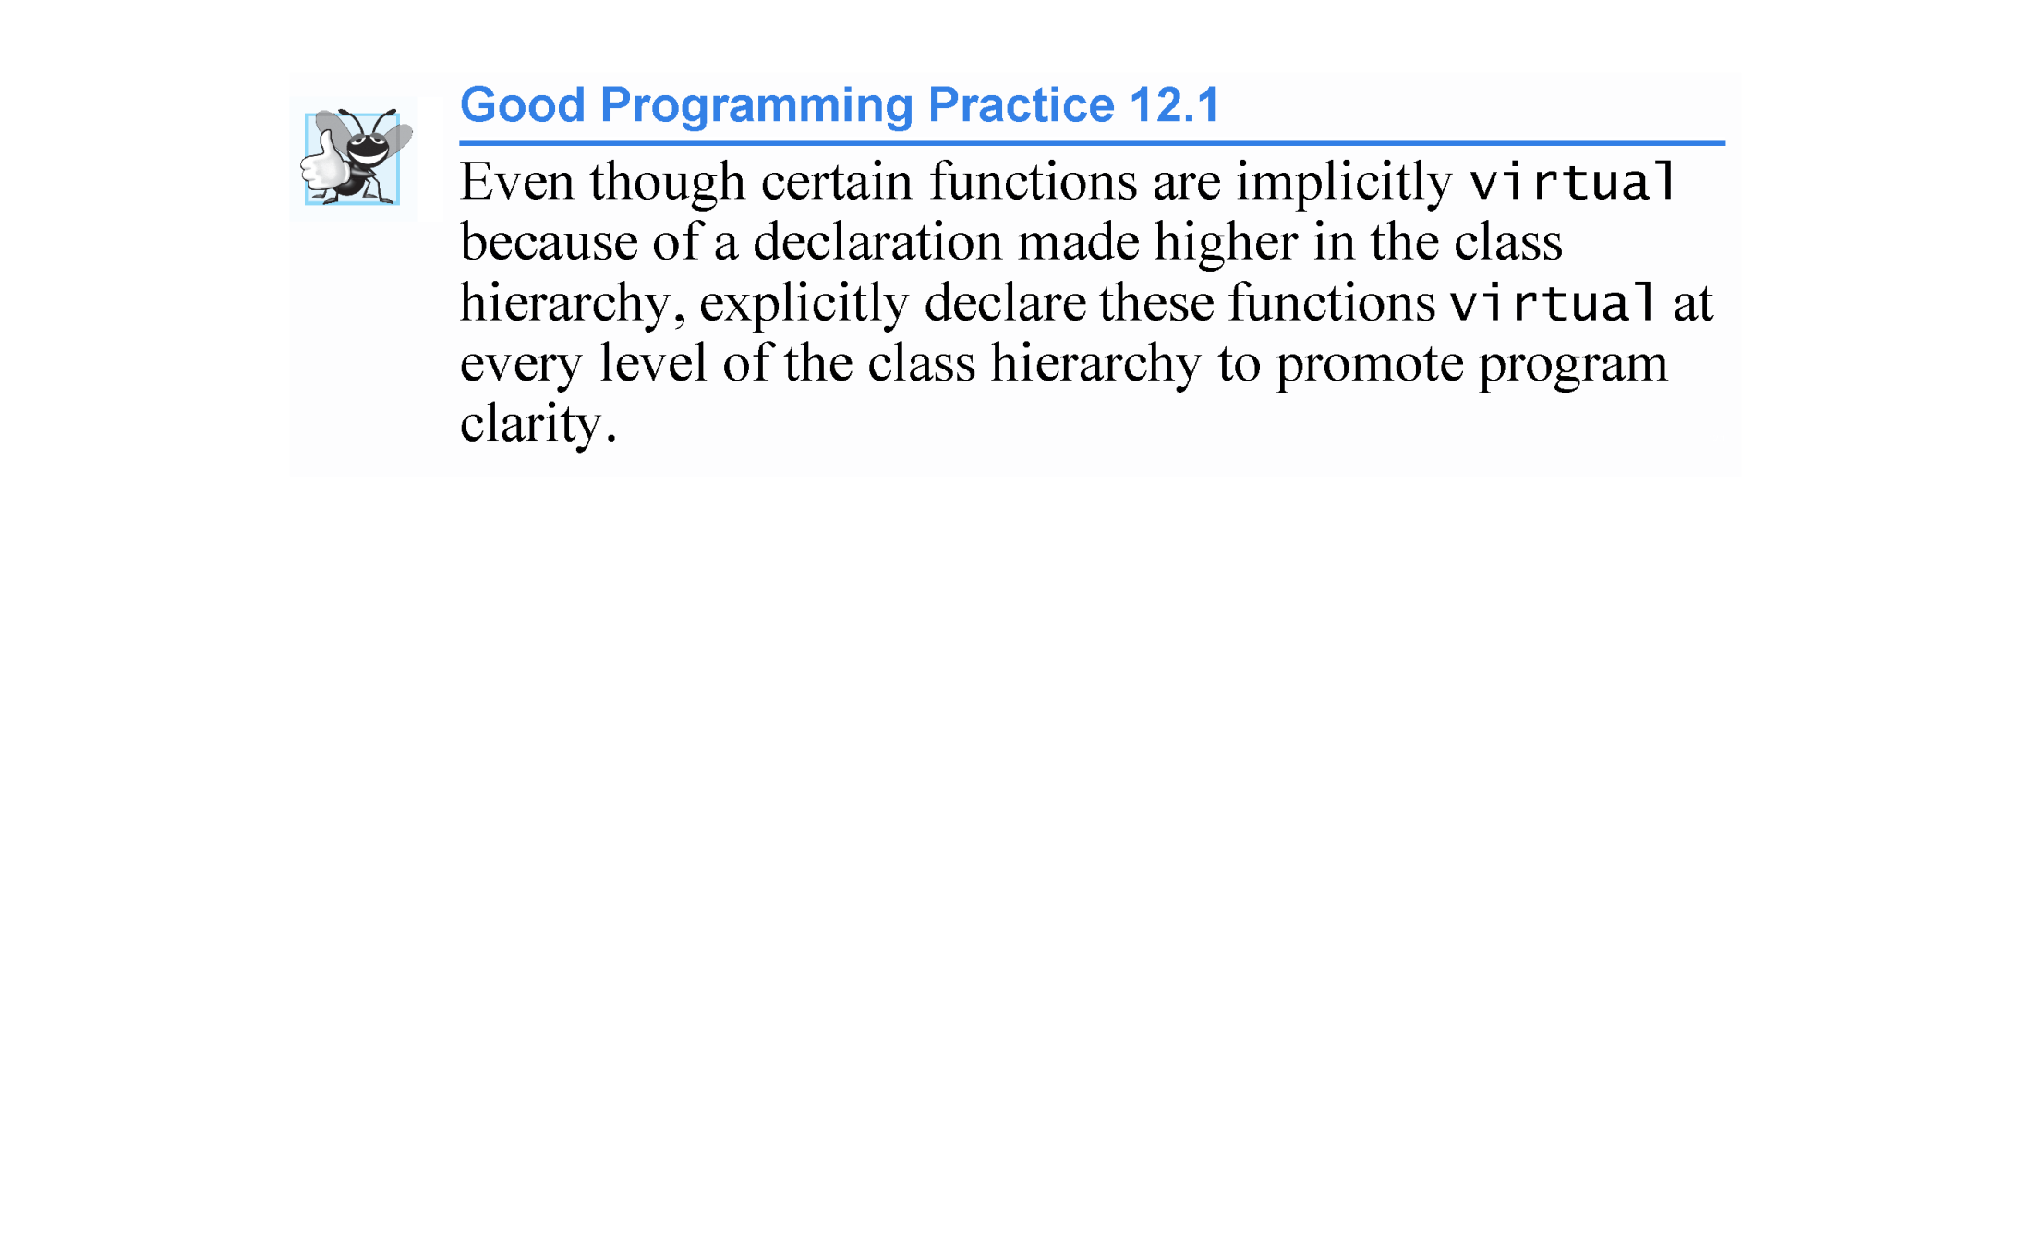

Slide 32
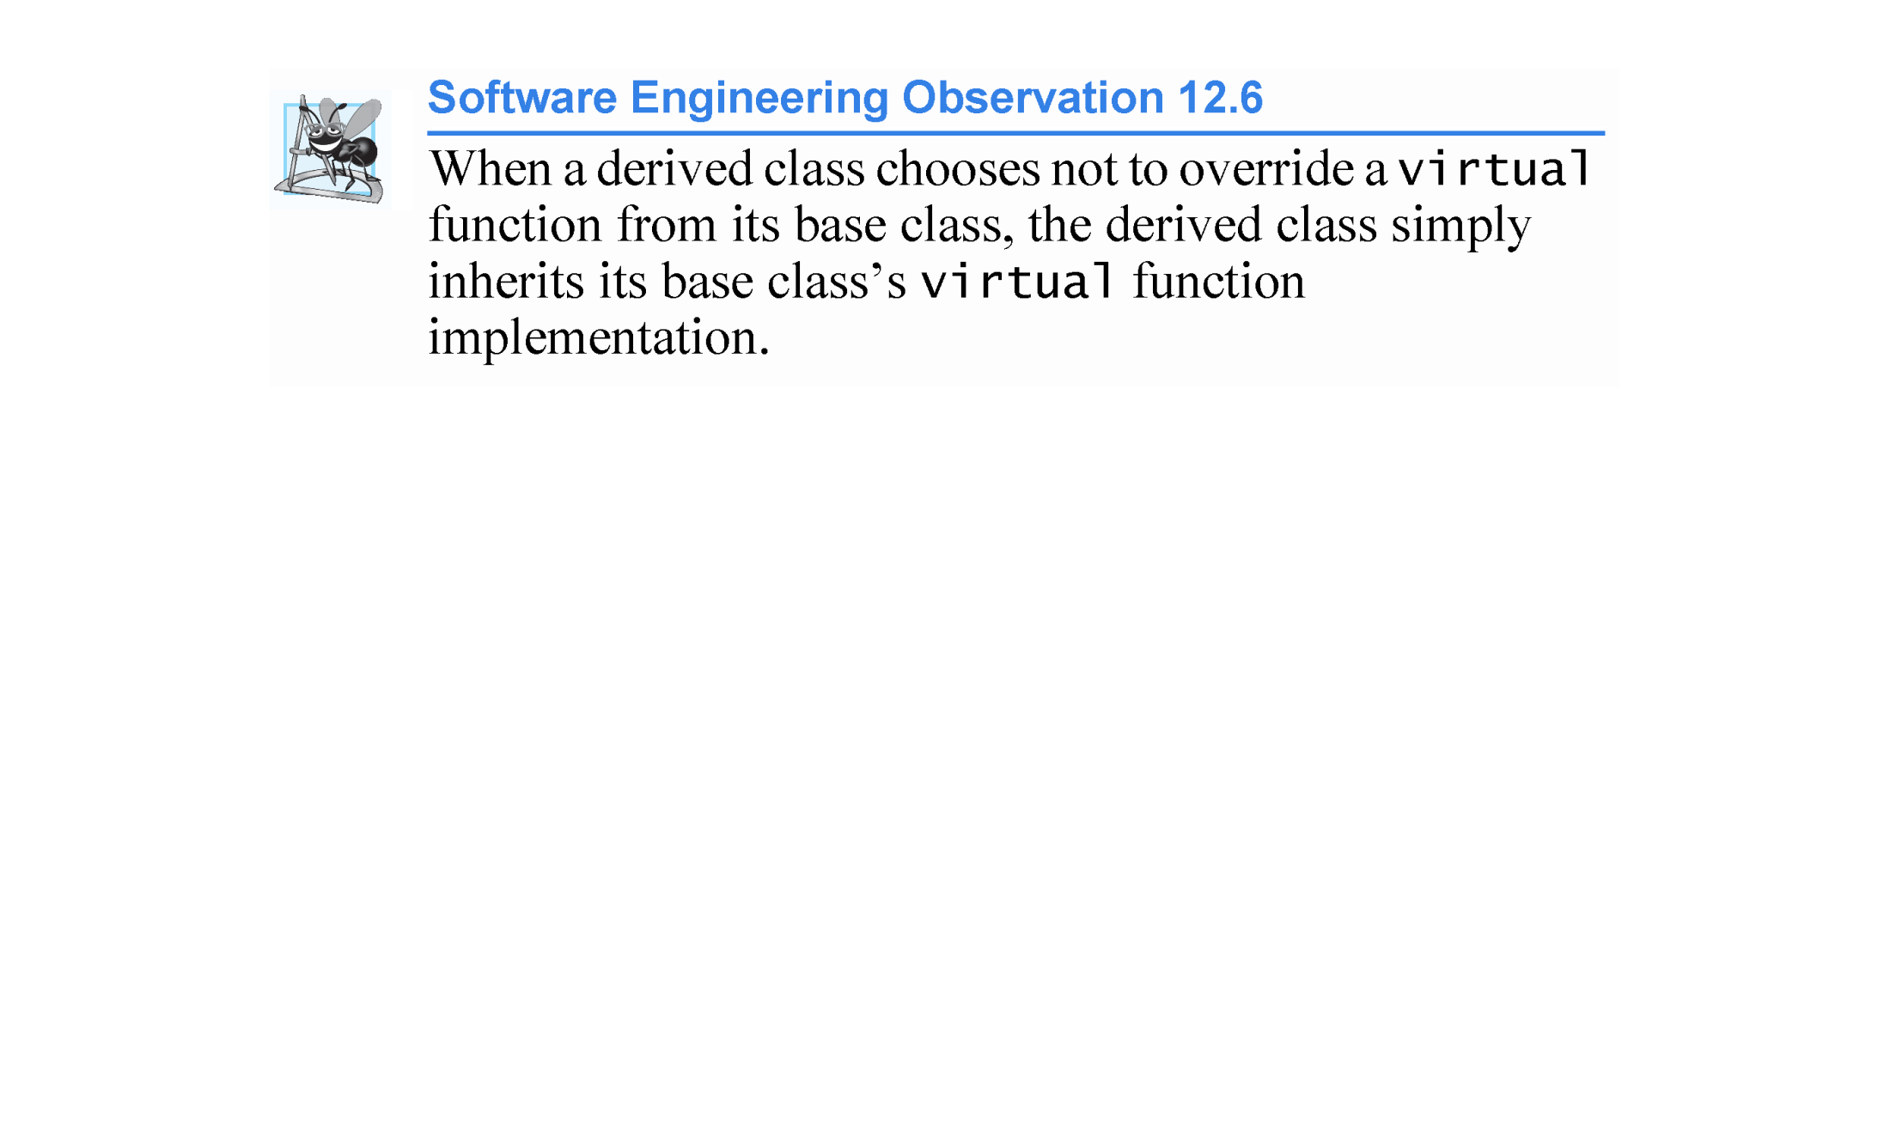

Slide 33
12.3.4 Virtual Functions and Virtual Destructors (cont.)
Invoking a virtual Function Through a Base-Class Pointer or Reference
If a program invokes a virtual function through a base-class pointer to a derived-class object (e.g., shapePtr->draw()) or a base-class reference to a derived-class object (e.g., shapeRef.draw()), the program will choose the correct derived-class function dynamically (i.e., at execution time) based on the object type—not the pointer or reference type.
This is known as dynamic binding or late binding.

Slide 34
12.3.4 Virtual Functions and Virtual Destructors (cont.)
Invoking a virtual Function Through an Object’s Name
When a virtual function is called by referencing a specific object by name (not using a reference or a pointer) and using the dot member-selection operator (e.g., squareObject.draw()), the function invocation is re-solved at compile time (this is called static binding) and the virtual function that is called is the one defined for (or inherited by) the class of that particular object—this is not polymorphic behavior.
Dynamic binding with virtual functions occurs only off pointers (and, as we’ll soon see, references).

Slide 35
12.3.4 Virtual Functions and Virtual Destructors (cont.)
virtual Functions in the CommissionEmployee Hierarchy
Figures 12.4–12.5 are the headers for classes CommissionEmployee and BasePlusCommissionEmployee, respectively.
We modified these to declare each class’s earnings and print member functions as virtual (lines 29–30 of Fig. 12.4 and lines 19–20 of Fig. 12.5).
Because functions earnings and print are virtual in class CommissionEmployee, class BasePlusCommissionEmployee’s earnings and print functions override class CommissionEmployee’s.
In addition, class BasePlusCommissionEmployee’s earnings and print functions are declared override.

Slide 36
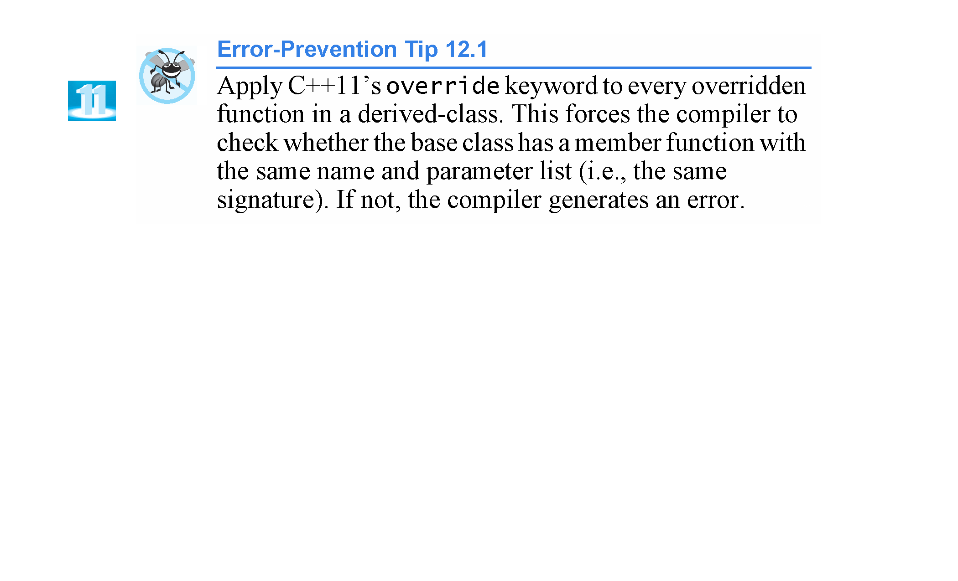

Slide 37
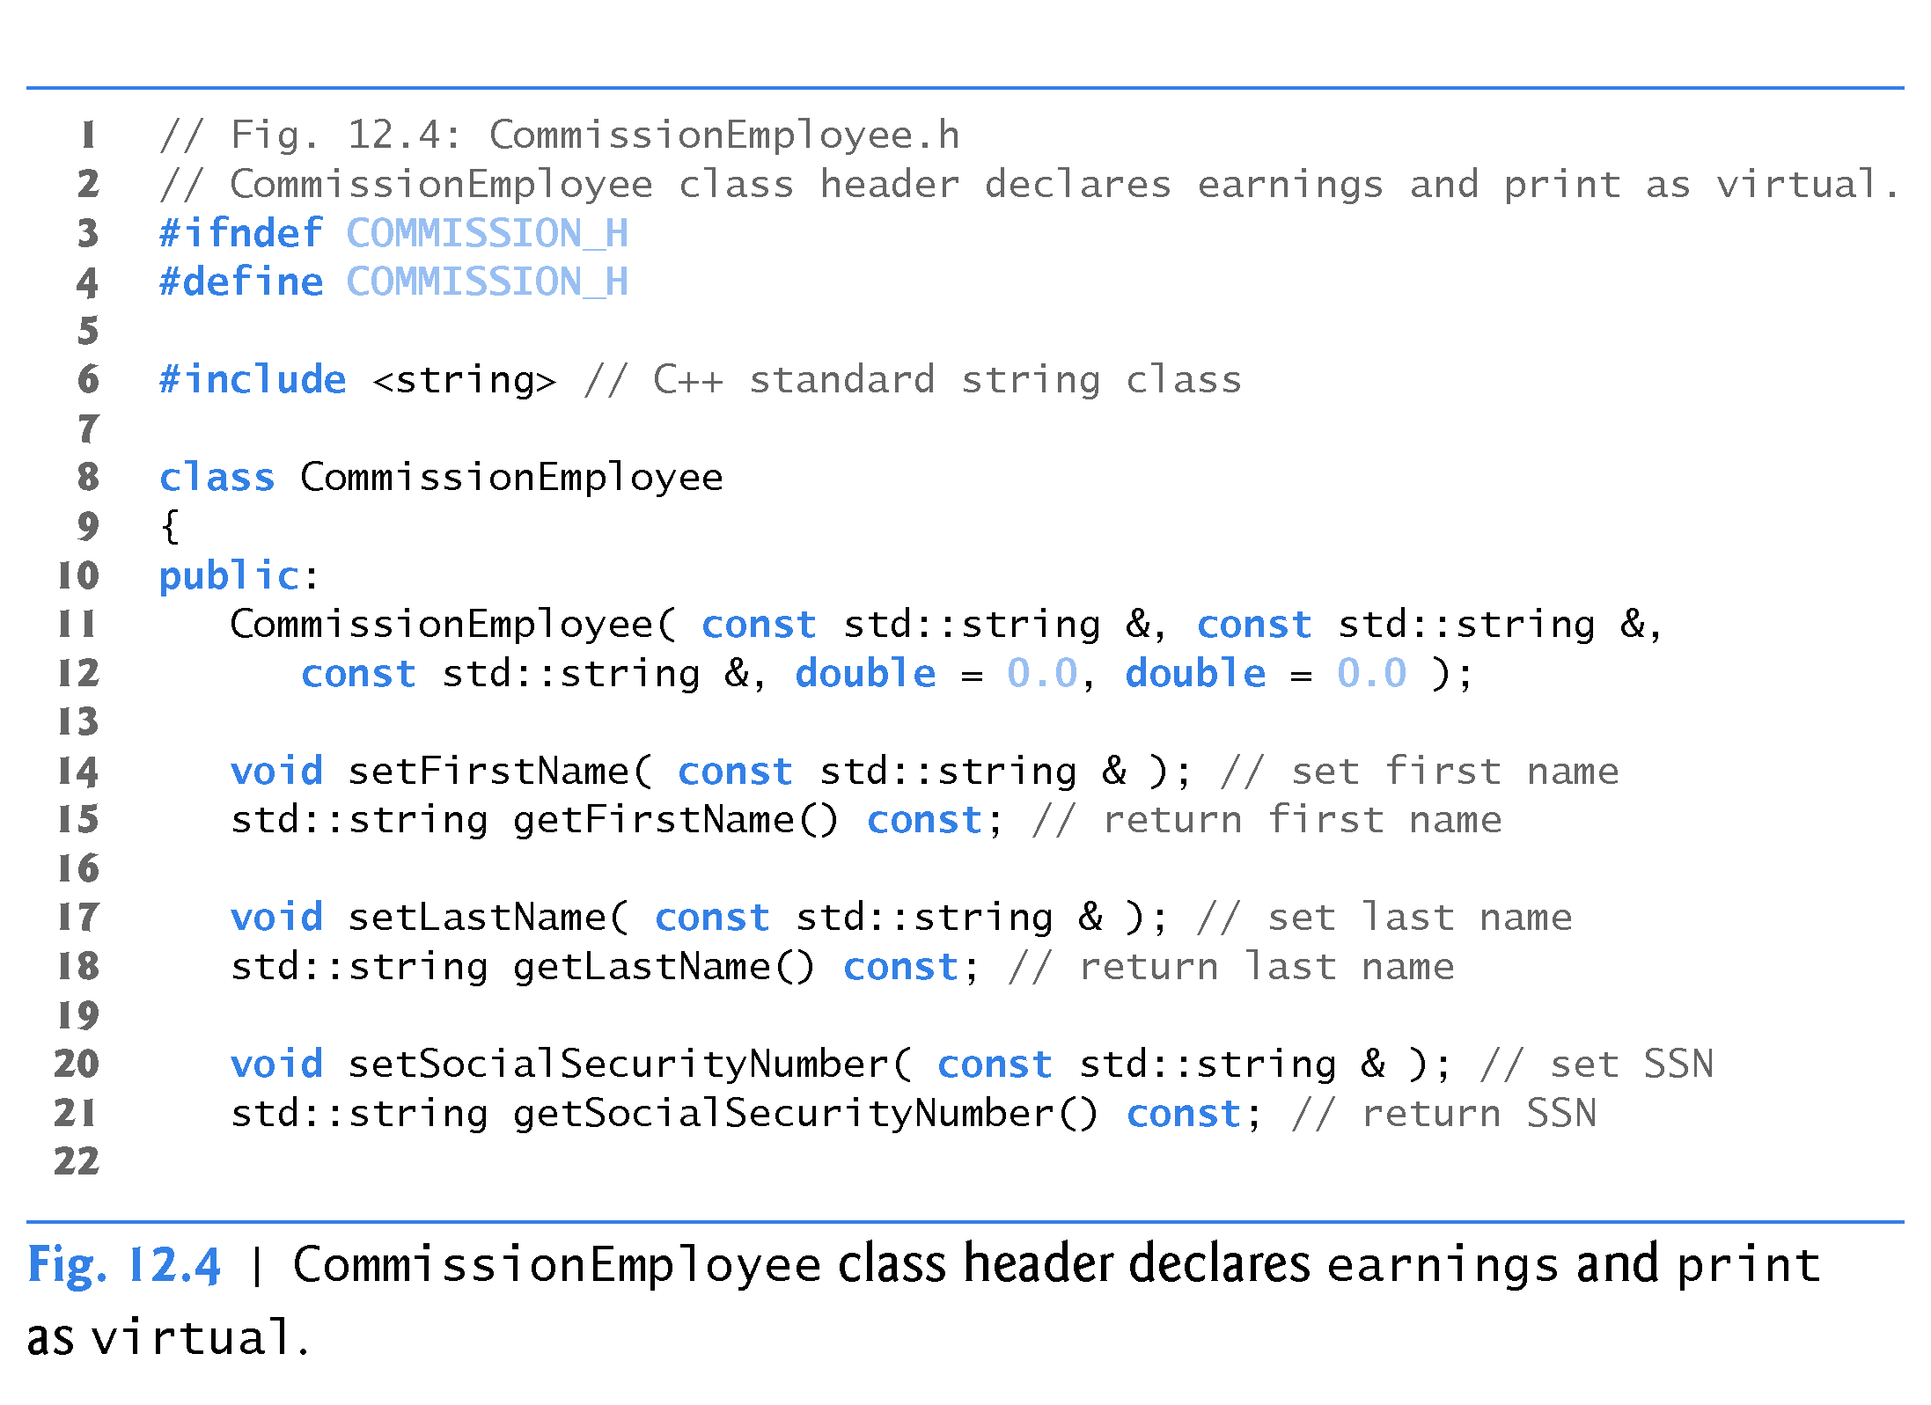

Slide 38
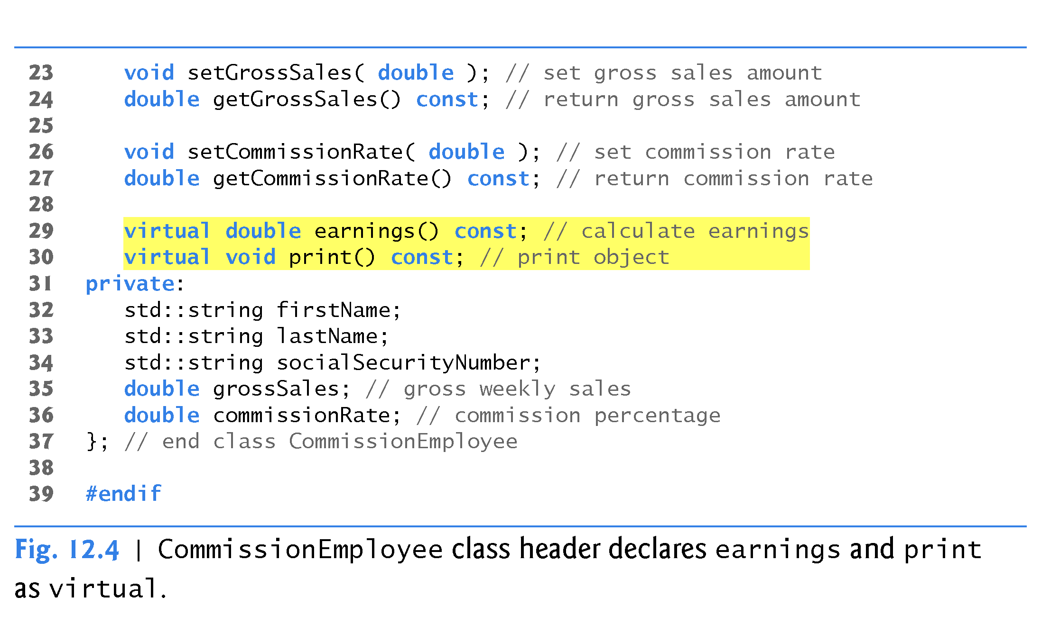
no override keyword because this is a base class. Override keyword is used in derived classes.

Slide 39
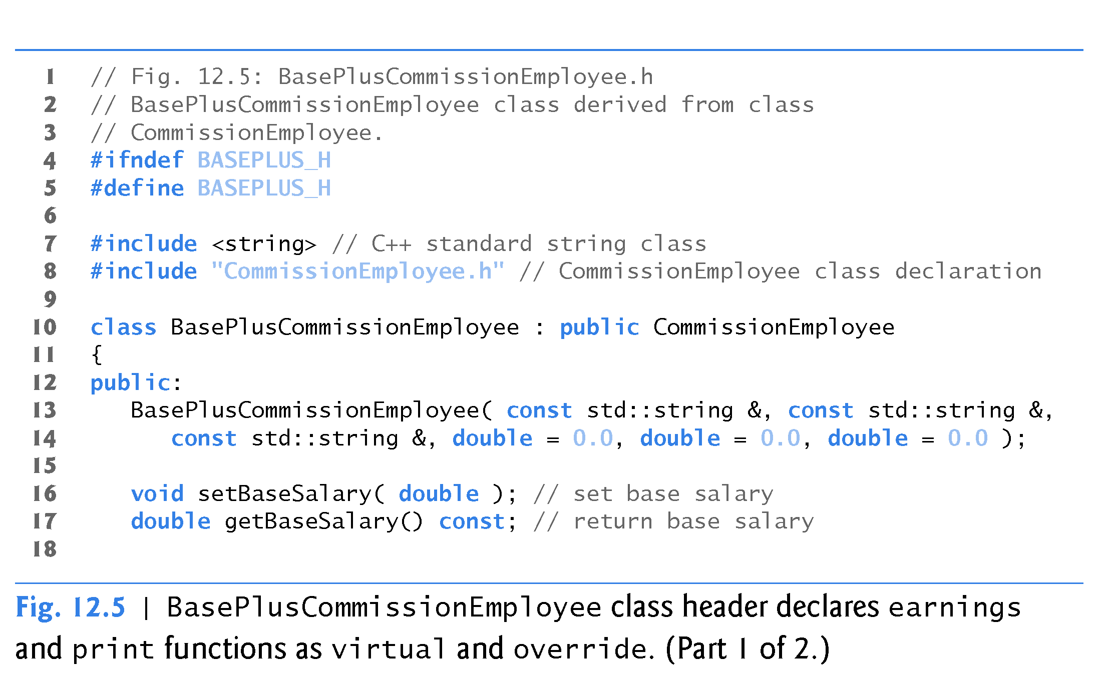

Slide 40
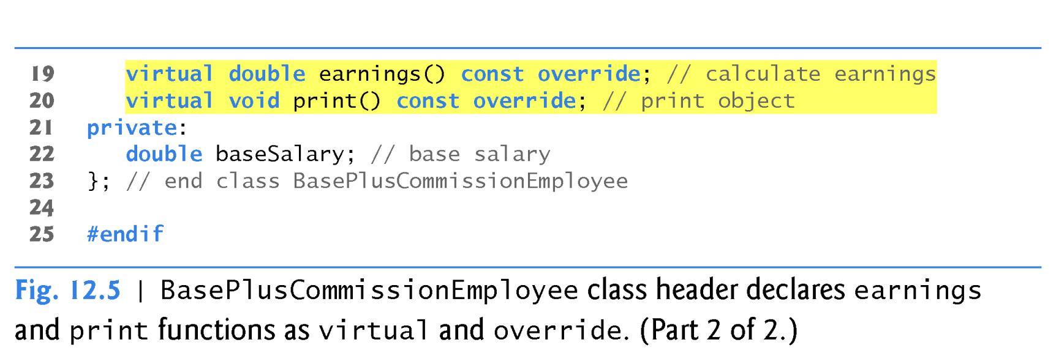
keyword virtual is not required in the prototypes of lines 19 and 20. These are implicitly virtual functions.
Notice override keyword!

Slide 41
12.3.4 Virtual Functions and Virtual Destructors (cont.)
We modified Fig. 12.1 to create the program of Fig. 12.6 (next slide). Function print( ) is declared virtual in class CommissionEmployee.
We see that declaring a member function virtual causes the program to dynamically determine which function to invoke based on the type of object to which the handle points, rather than on the type of the handle.

Slide 42
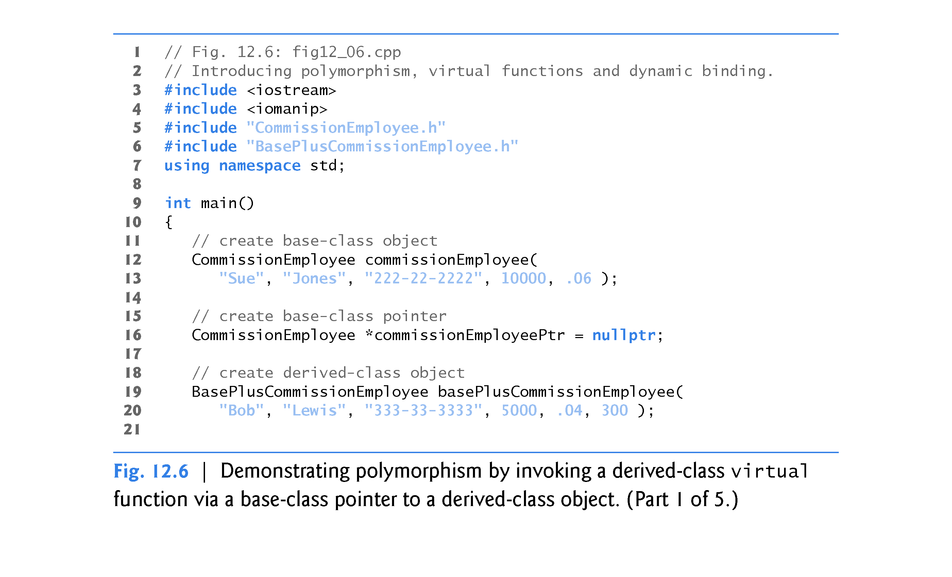

Slide 43
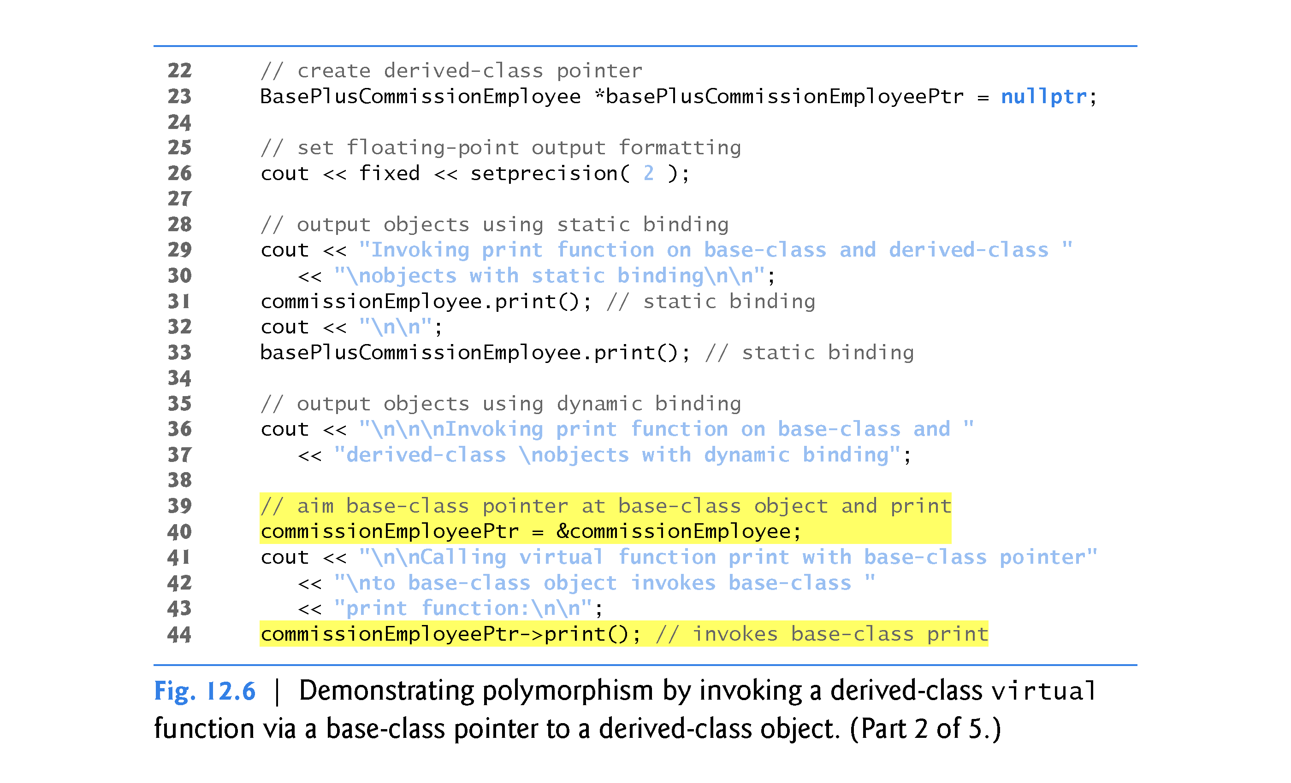

Slide 44
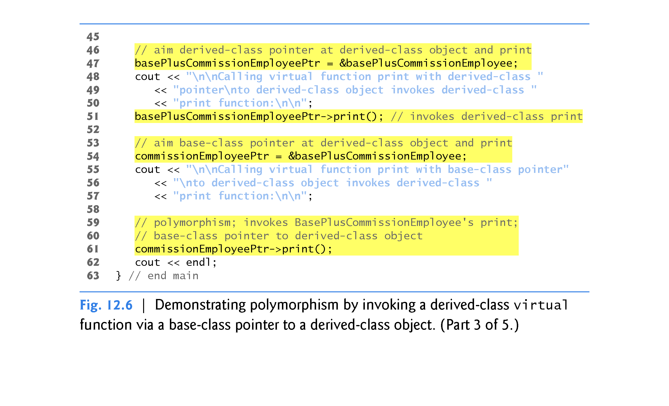

Slide 45
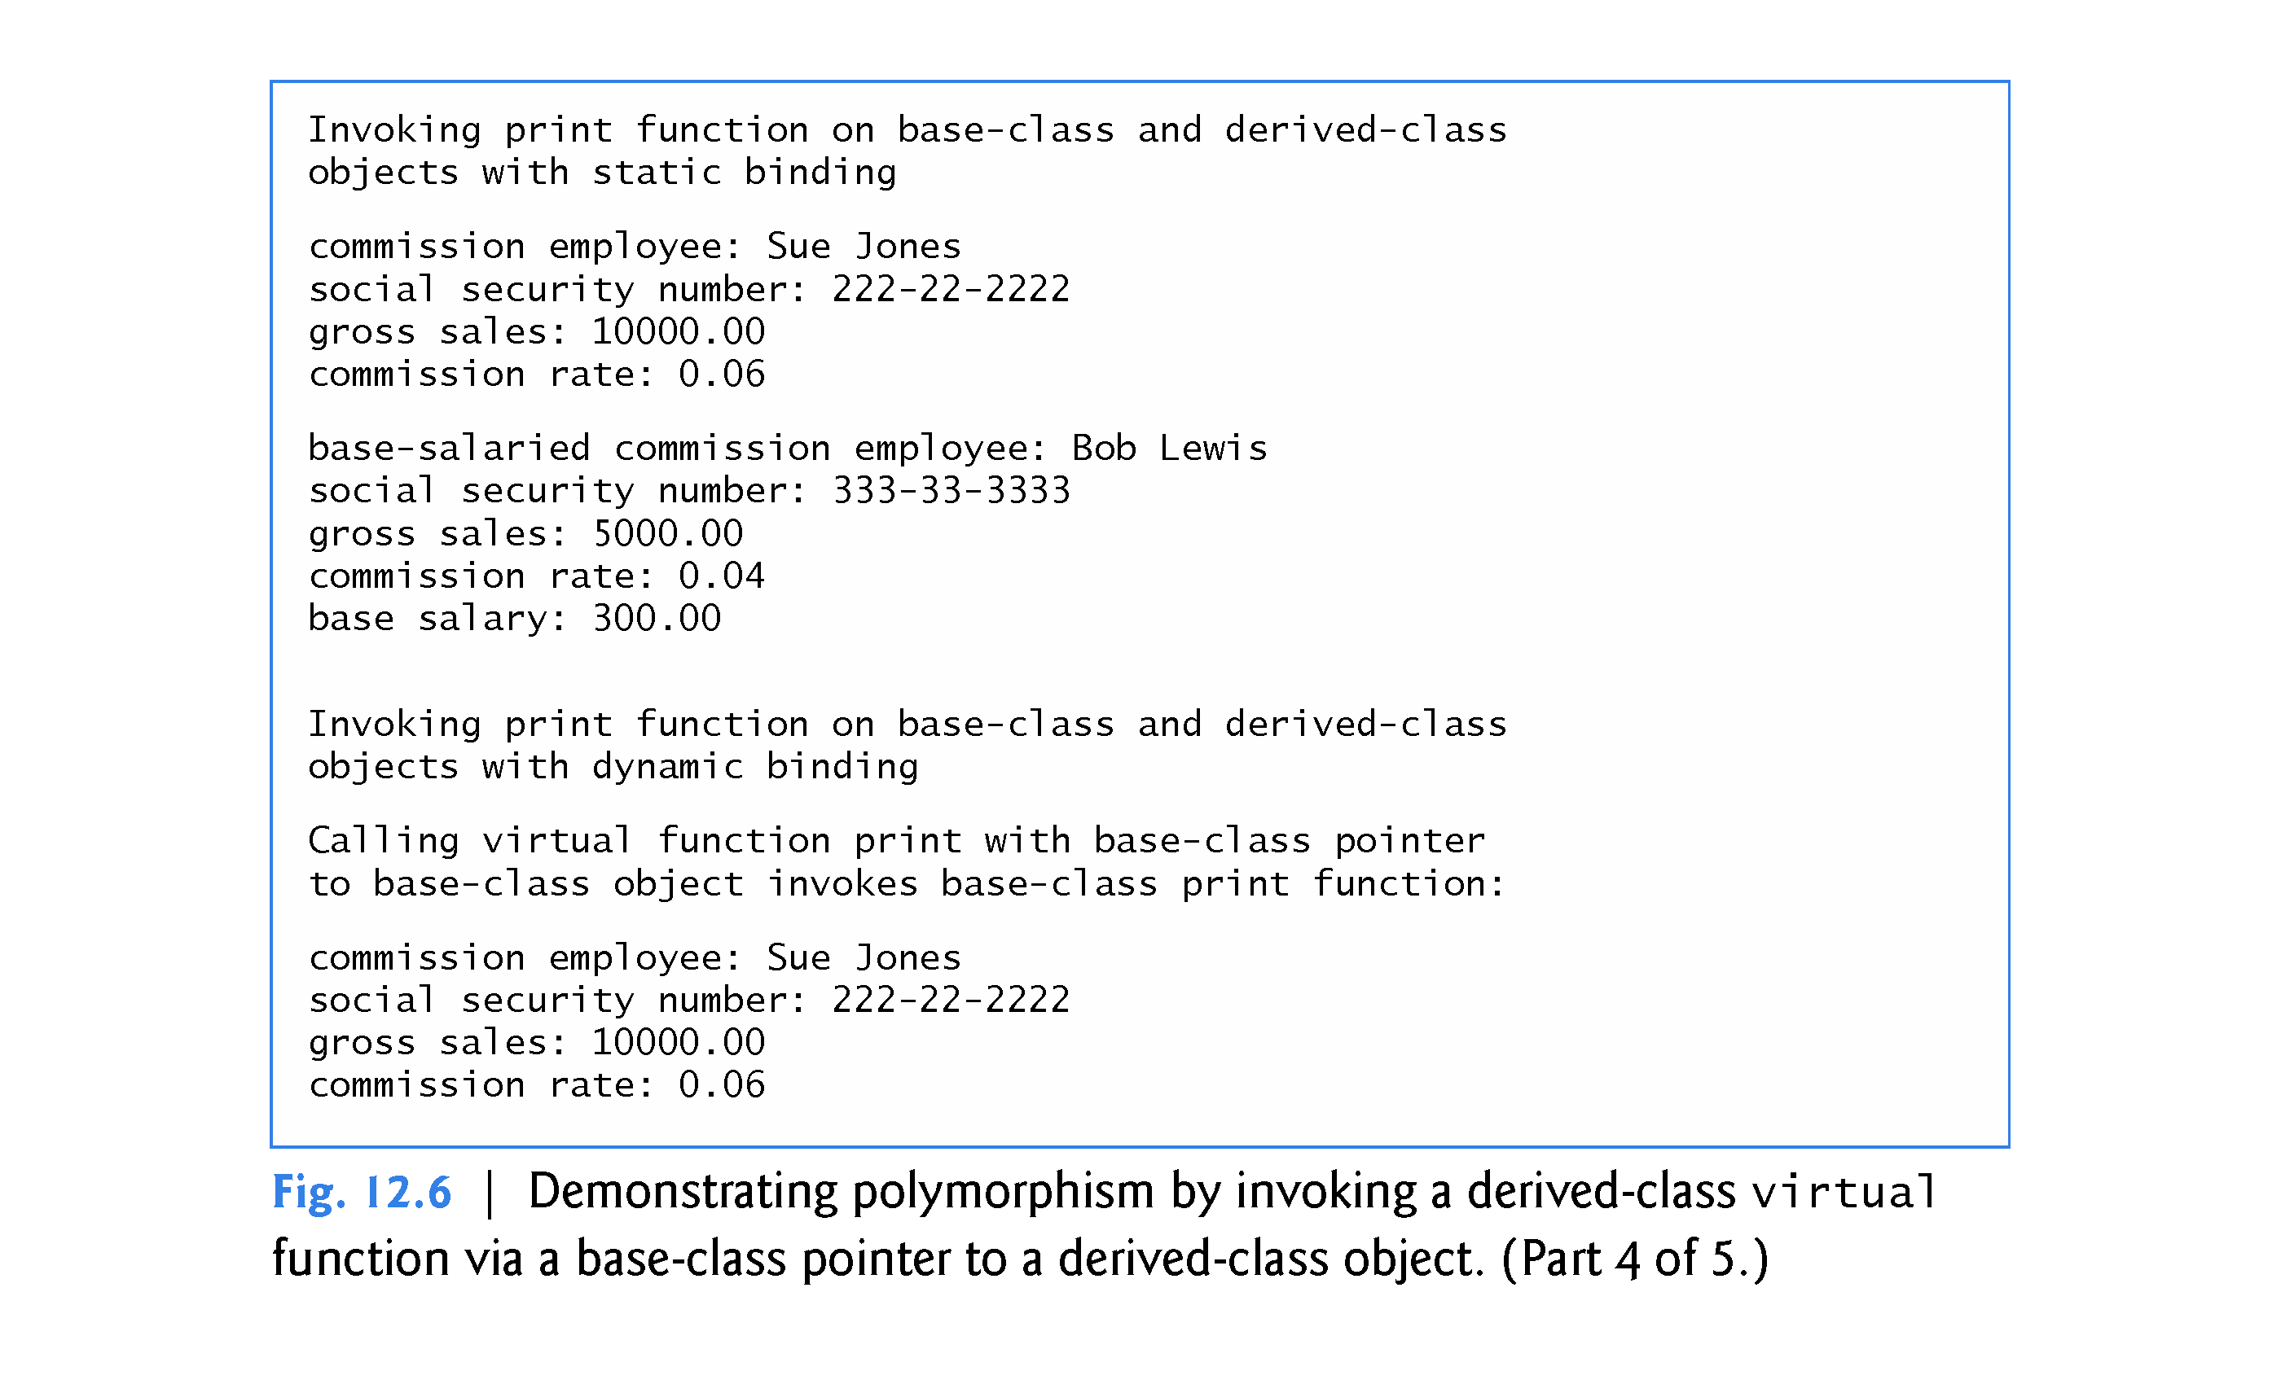

Slide 46
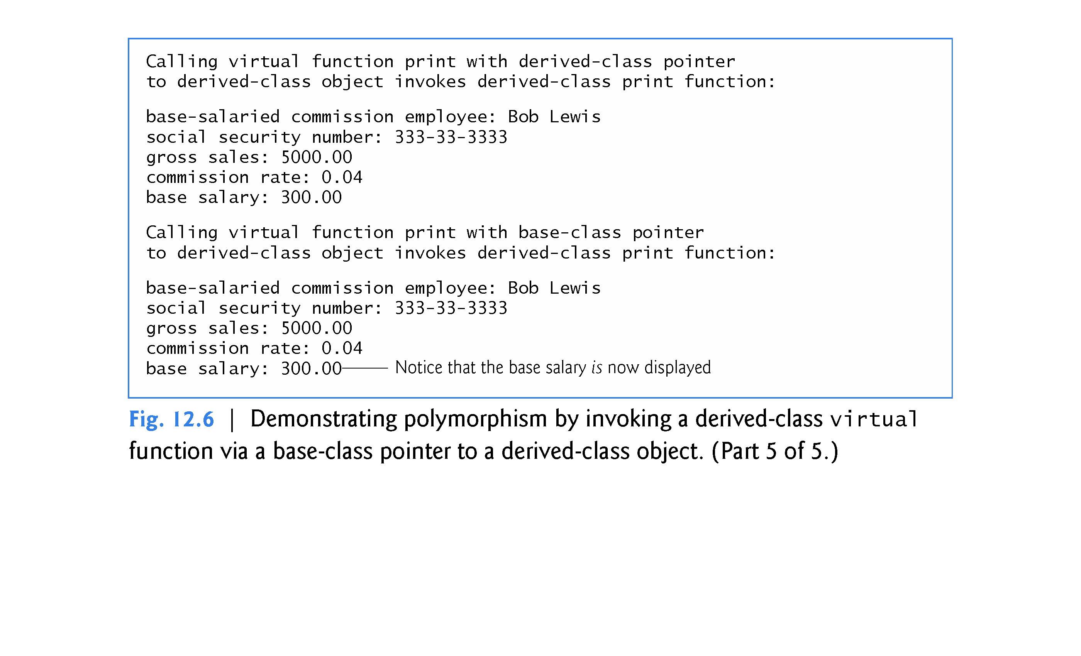

Slide 47
12.3.4 Virtual Functions and Virtual Destructors (cont.)
virtual Destructors
A problem can occur when using polymorphism to process dynamically allocated objects of a class hierarchy
If a derived-class object with a non-virtual destructor is destroyed by applying the delete operator to a base-class pointer to the object, the C++ standard specifies that the behavior is undefined. delete ptr;
The simple solution to this problem is to create a public virtual destructor in the base class.
If a base class destructor is declared virtual, the destructors of any derived classes are also virtual and they override the base class destructor.

Slide 48
12.3.4 Virtual Functions and Virtual Destructors (cont.)
For example, in class CommissionEmployee’s definition:
virtual ~CommissionEmployee() { } //note empty body
Now, if an object in the hierarchy is destroyed explicitly by applying the delete operator to a base-class pointer, the destructor for the appropriate class is called based on the object to which the base-class pointer points.
Remember, when a derived-class object is destroyed, the base-class part of the derived-class object is also destroyed, so it’s important for the destructors of both the derived and base classes to execute.
The base-class destructor automatically executes after the derived-class destructor.

Slide 49
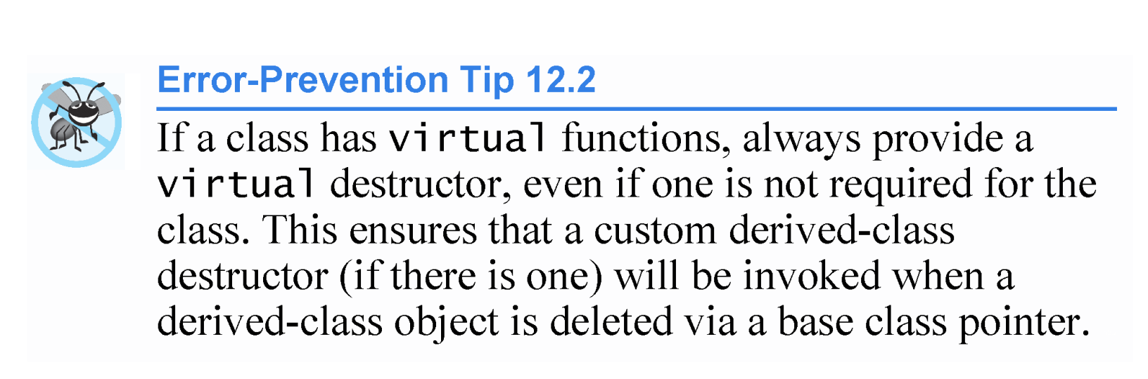

Slide 50
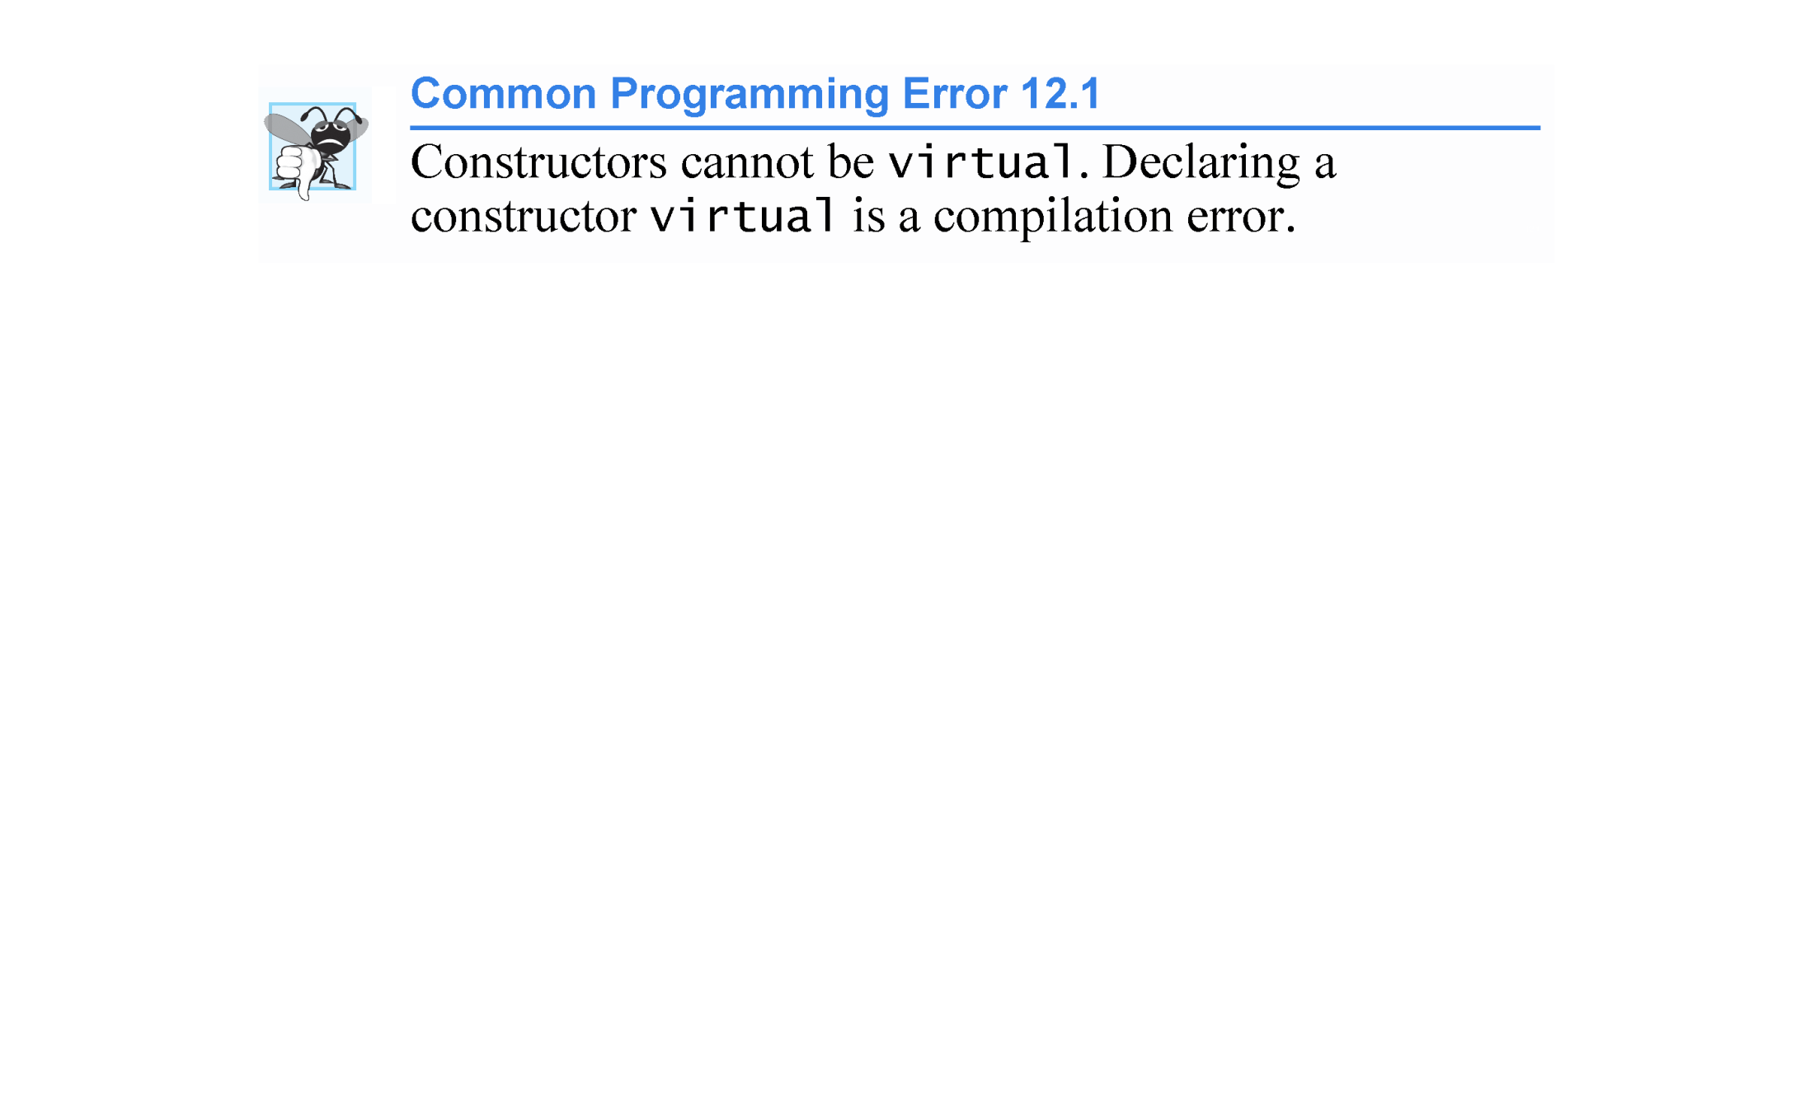

Slide 51
12.3.4 Virtual Functions and Virtual Destructors (cont.)
C++11: final Member Functions and Classes
In C++11, a base-class virtual function that’s declared final in its prototype, as in
virtual someFunction( parameters ) final;
Note: Java has always allowed final methods and classes
cannot be overridden in any derived class—this guarantees that the base class’s final member function definition will be used by all base-class objects and by all objects of the base class’s direct and indirect derived classes.

Slide 52
12.3.4 Virtual Functions and Virtual Destructors (cont.)
As of C++11, you can declare a class as final to prevent it from being used as a base class, as in
class MyClass final // this class cannot be a base class
{
// class body
};
Attempting to override a final member function or inherit from a final base class results in a compilation error.

Slide 53
12.4 Type Fields and switch Statements
OMIT

Slide 54
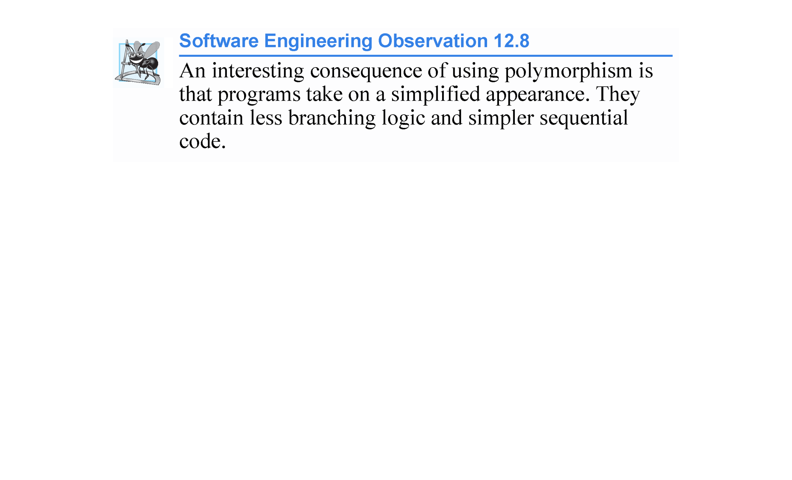

Slide 55
12.5 Abstract Classes and Pure virtual Functions
There are cases in which it’s useful to define classes from which you never intend to instantiate any objects.
Such classes are called abstract classes.
These classes normally are used as base classes in inheritance hierarchies
These classes cannot be used to instantiate objects, because, as we’ll soon see, abstract classes are incomplete - derived classes must define the “missing pieces.”
An abstract class is a base class from which other classes can inherit.
Classes that can be used to instantiate objects are called concrete classes.
Such classes define every member function they declare.

Slide 56
12.5 Abstract Classes and Pure virtual Functions
An inheritance hierarchy does not need to contain any abstract classes, but many object-oriented systems have class hierarchies headed by abstract base classes.
In some cases, abstract classes constitute the top few levels of the hierarchy.
A good example of this is the shape hierarchy in Fig. 12.3, which begins with abstract base class Shape.
Note: In Java a class can be declared abstract even if it does not contain any abstract methods. You cannot do this in C++;

Slide 57
12.5 Abstract Classes and Pure virtual Functions
Pure Virtual Functions
A class is made abstract by declaring one or more of its virtual functions to be “pure.” A pure virtual function is specified by placing “= 0” in its declaration, as in
virtual void draw( ) const = 0; // pure virtual function
The “= 0” is a pure specifier.
Note: There is no abstract keyword in C++ and abstract is not included in the class header as it is in Java

Slide 58
12.5 Abstract Classes and Pure virtual Functions
Each concrete derived class must override all base-class pure virtual functions with concrete implementations of those functions; otherwise the derived class is also abstract.
The difference between a virtual function and a pure virtual function is that a virtual function has an implementation and gives the derived class the option of overriding the function.
By contrast, a pure virtual function does not have an implementation and requires the derived class to override the function for that derived class to be concrete; otherwise the derived class remains abstract.
Pure virtual functions are used when it does not make sense for the base class to have an implementation of a function, but you want all concrete derived classes to implement the function.

Slide 59
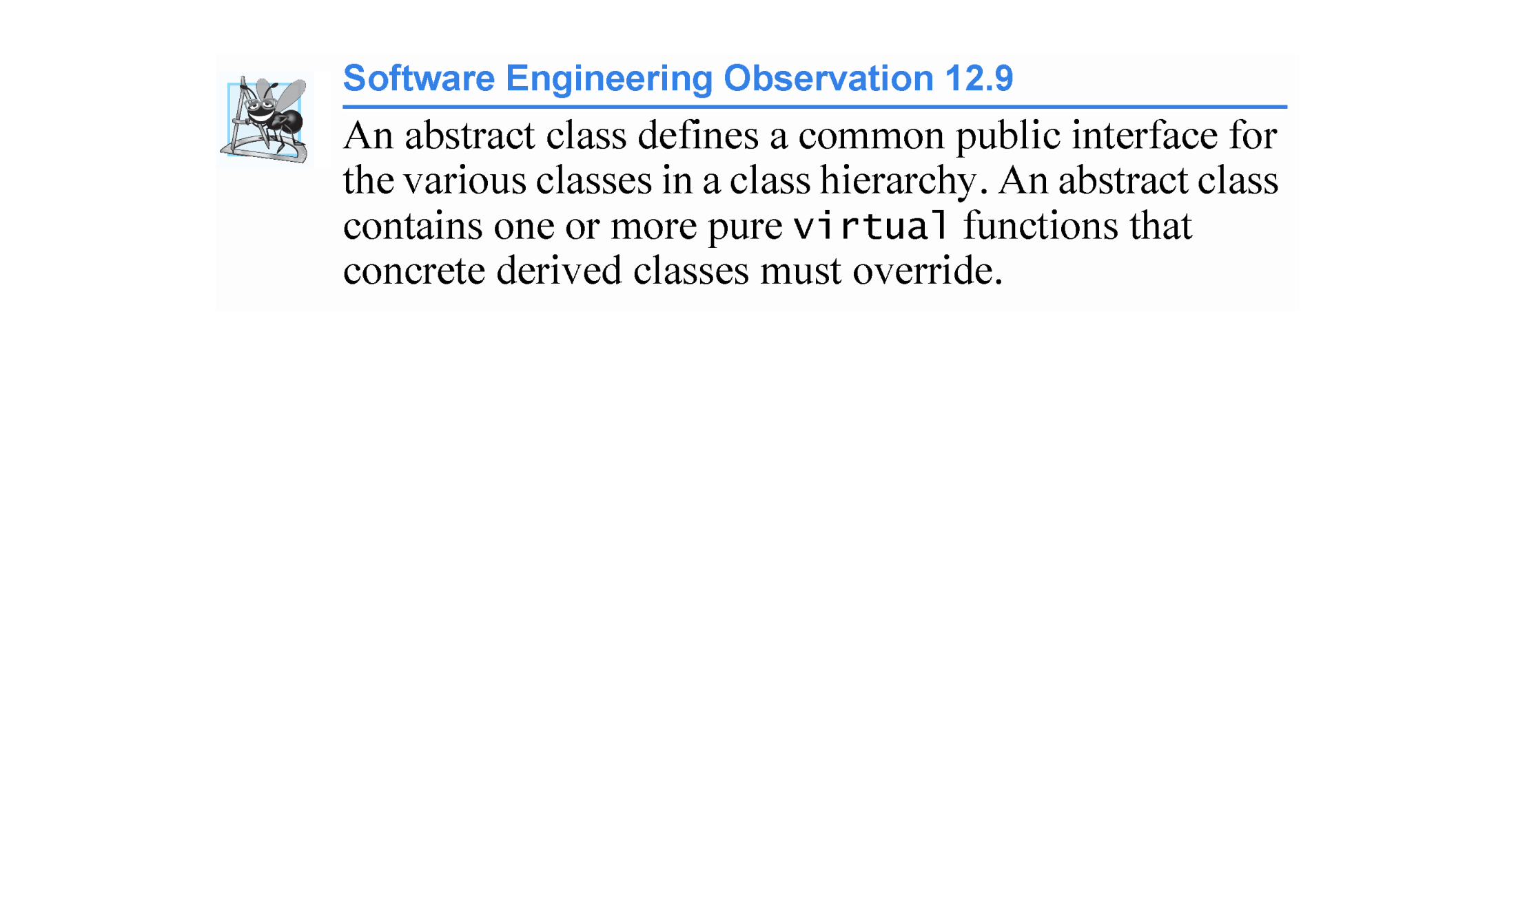

Slide 60
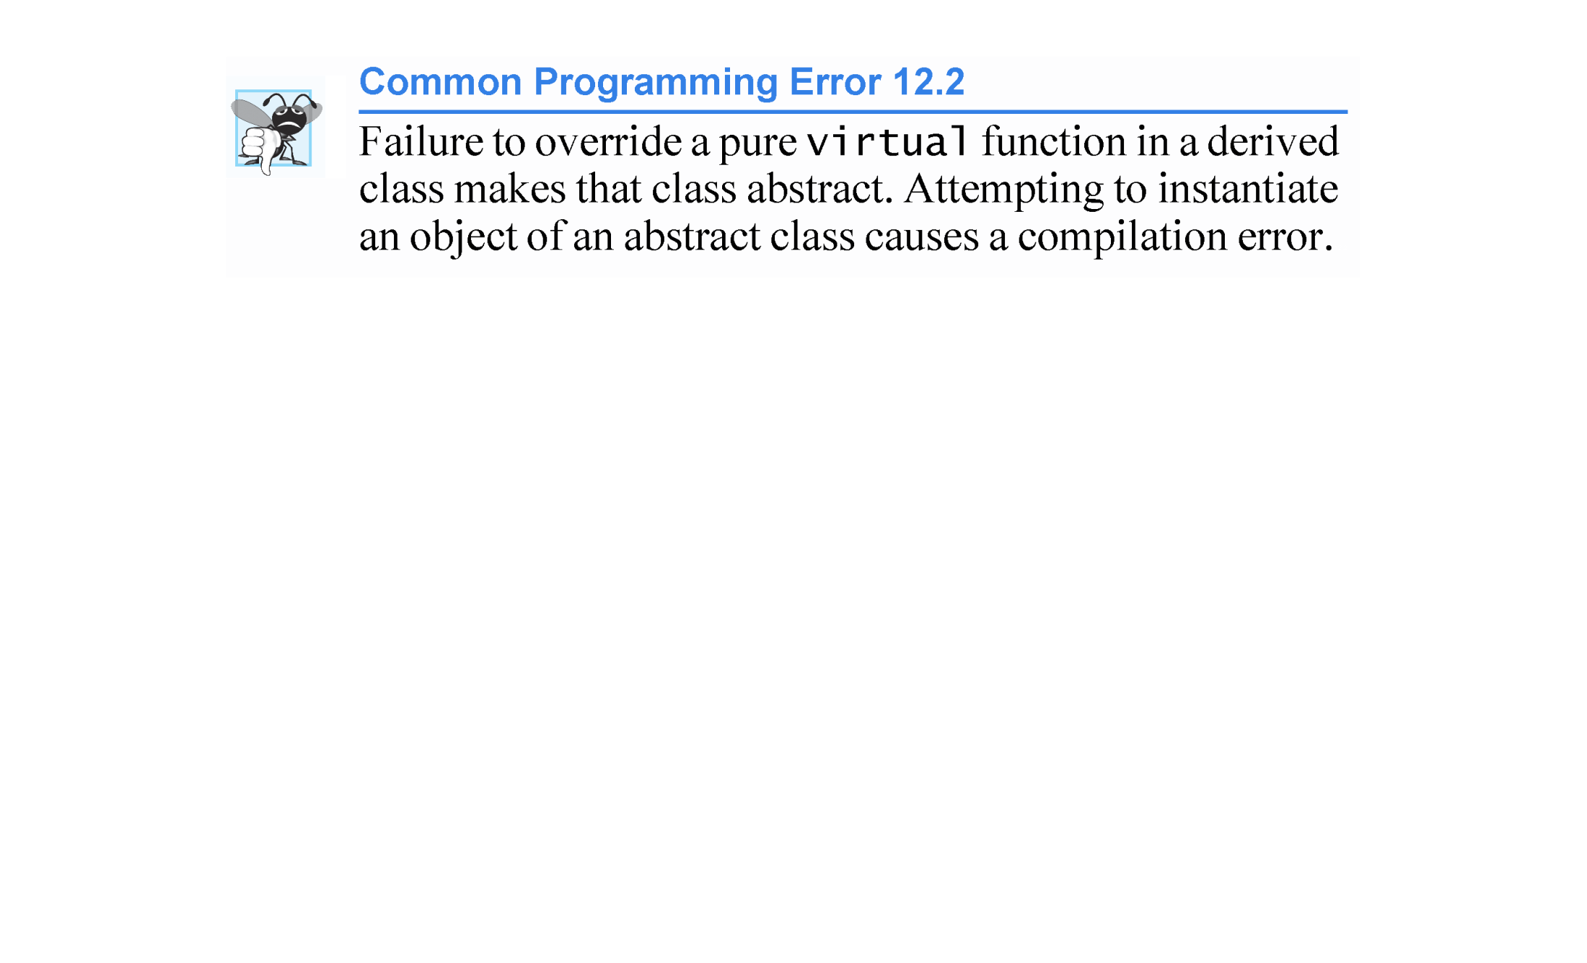

Slide 61
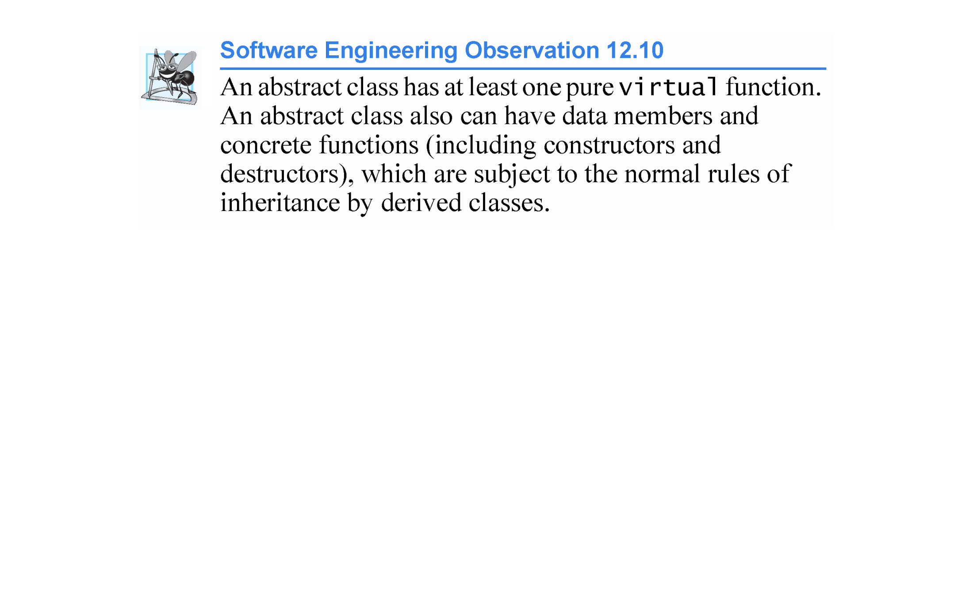

Slide 62
12.5 Abstract Classes and Pure virtual Functions
Although we cannot instantiate objects of an abstract base class, we can use the abstract base class to declare pointers and references that can refer to objects of any concrete classes derived from the abstract class.
Programs typically use such pointers and references to manipulate derived-class objects polymorphically.

Slide 63
12.5 Abstract Classes and Pure virtual Functions
This section reexamines the CommissionEmployee-BasePlusCommissionEmployee hierarchy that we explored throughout Section 11.3.
We use an abstract class and polymorphism to perform payroll calculations based on the type of employee.

Slide 64
12.6 Case Study: Payroll System Using Polymorphism (cont.)
We create an enhanced employee hierarchy to solve the following problem:
A company pays its employees weekly. The employees are of three types: Salaried employees are paid a fixed weekly salary regardless of the number of hours worked, commission employees are paid a percentage of their sales and base-plus-commission employees receive a base salary plus a percentage of their sales.
For the current pay period, the company has decided to reward base-salary-plus-commission employees by adding 10 percent to their base salaries.
The company wants to implement a C++ program that performs its payroll calculations polymorphically.
We use abstract class Employee to represent the general concept of an employee.

Slide 65
12.6 Case Study: Payroll System Using Polymorphism (cont.)
The UML class diagram in Fig. 12.7 shows the inheritance hierarchy for our polymorphic employee payroll application.
The abstract class name Employee is italicized, as per the convention of the UML.
Abstract base class Employee declares the “interface” to the hierarchy—that is, the set of member functions that a program can invoke on all Employee objects.
Each employee, regardless of the way his or her earnings are calculated, has a first name, a last name and a social security number, so private data members firstName, lastName and socialSecurityNumber appear in abstract base class Employee.

Slide 66
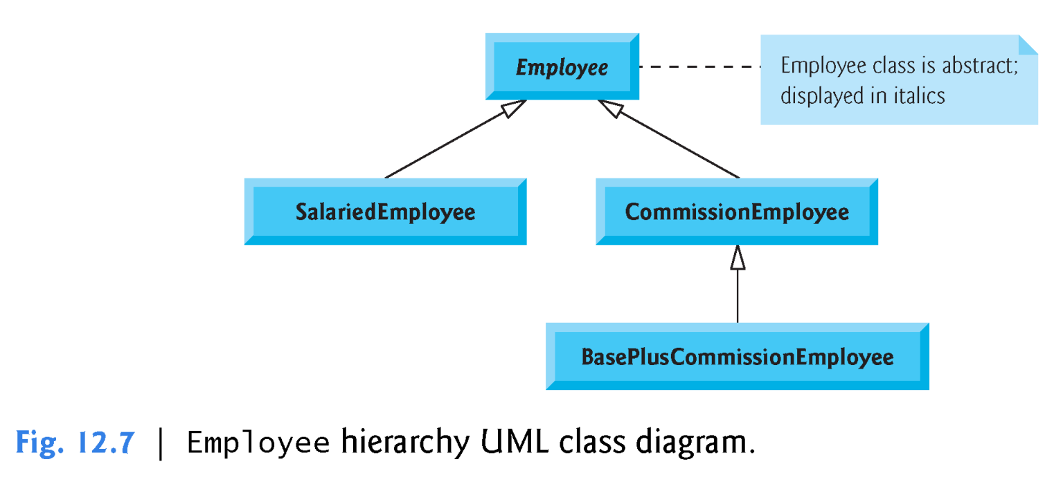

Slide 67
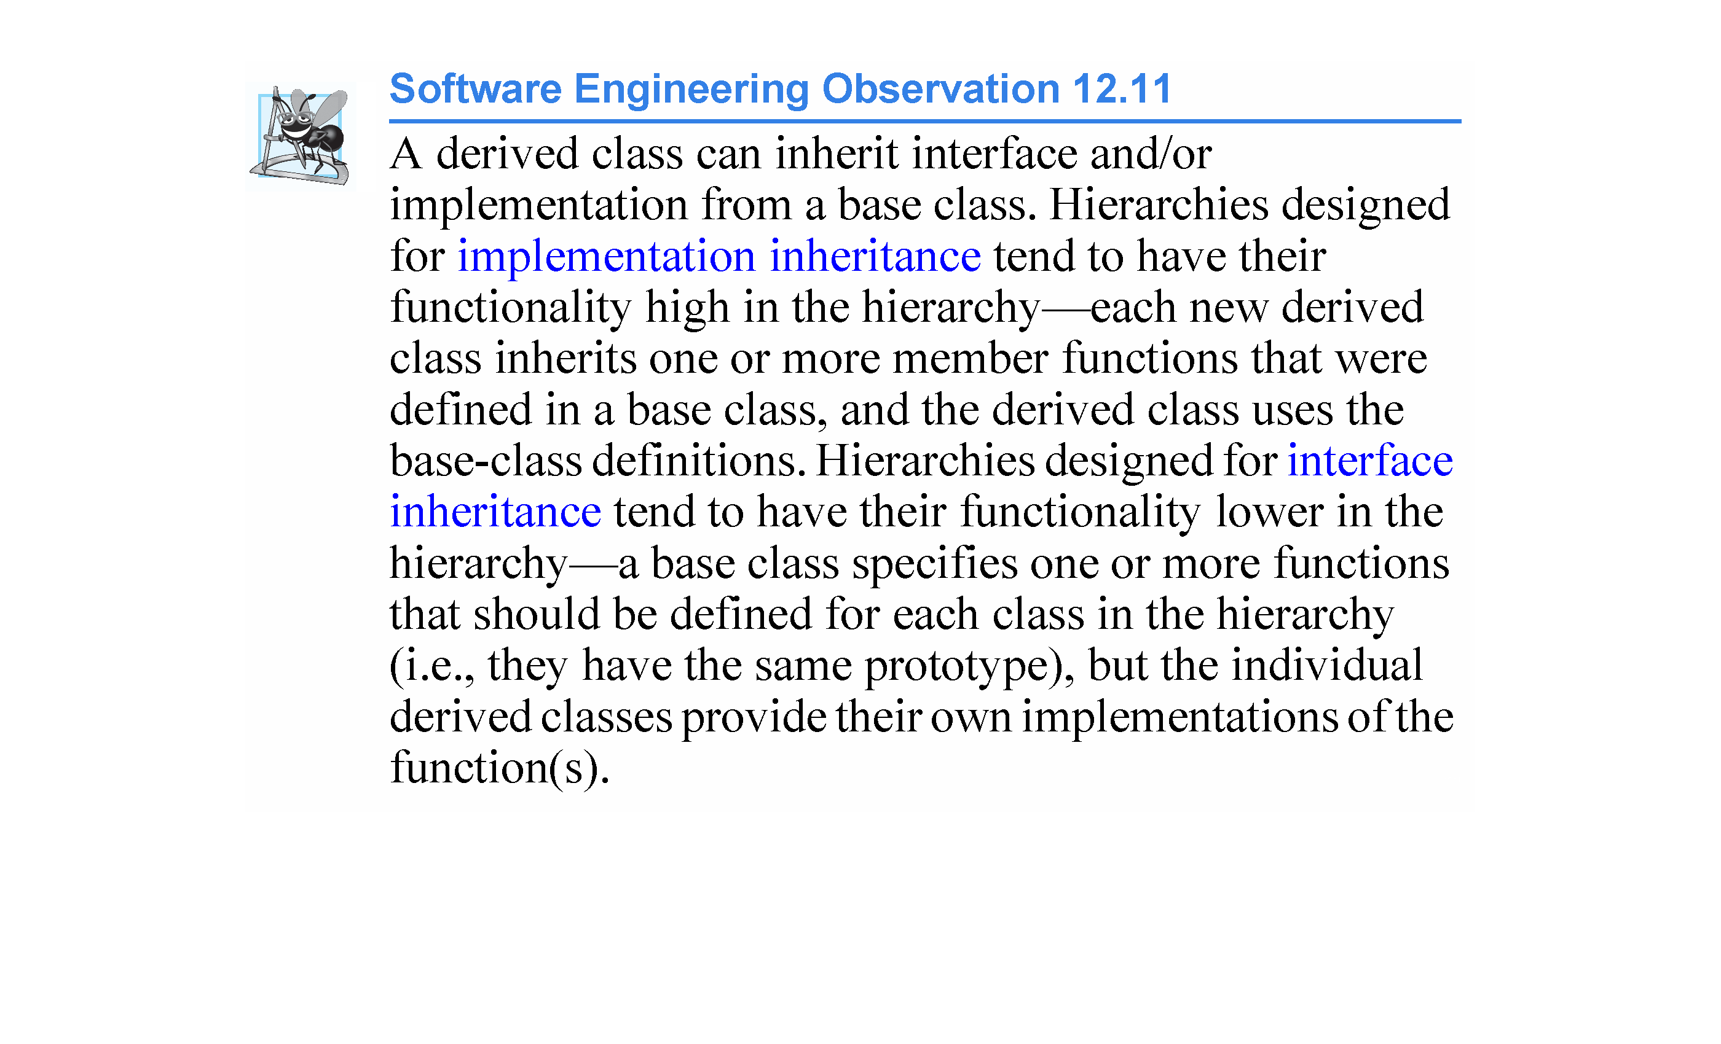

Slide 68
12.6.1 Creating Abstract Base Class Employee
Class Employee (Figs. 12.9–12.10) provides functions earnings and print, in addition to various get and set functions that manipulate Employee’s data members.
An earnings function certainly applies generally to all employees, but each earnings calculation depends on the employee’s class.
So we declare earnings as pure virtual in base class Employee because a default implementation does not make sense for that function—there is not enough information to determine what amount earnings should return.
Each derived class overrides earnings with an appropriate implementation.

Slide 69
12.6.1 Creating Abstract Base Class Employee (cont.)
To calculate an employee’s earnings, the program assigns the address of an employee’s object to a base class Employee pointer, then invokes the earnings function on that object. Base-class pointer to a derived-class object.
We maintain a vector of Employee pointers, each of which points to an Employee object
The program iterates through the vector and calls function earnings for each Employee object.
C++ processes these function calls polymorphically.
Including earnings as a pure virtual function in Employee forces every direct derived class of Employee that wishes to be a concrete class to override earnings.
This enables the designer of the class hierarchy to demand that each derived class provide an appropriate pay calculation, if indeed that derived class is to be concrete.

Slide 70
12.6.1 Creating Abstract Base Class Employee (cont.)
Function print in class Employee displays the first name, last name and social security number of the employee.
As we’ll see, each derived class of Employee overrides function print to output the employee’s type (e.g., "salaried employee:") followed by the rest of the employee’s information.
The diagram in Fig. 12.8 (next slide) shows each of the five classes in the hierarchy down the left side and functions earnings and print across the top.

Slide 71
12.6.1 Creating Abstract Base Class Employee (cont.)
Fig 12-08:
Italic text represents where the values from a particular object are used in the earnings and print functions.
Class Employee declares function earnings as a pure virtual function.
Each derived class overrides this function to provide an appropriate implementation.

Slide 72
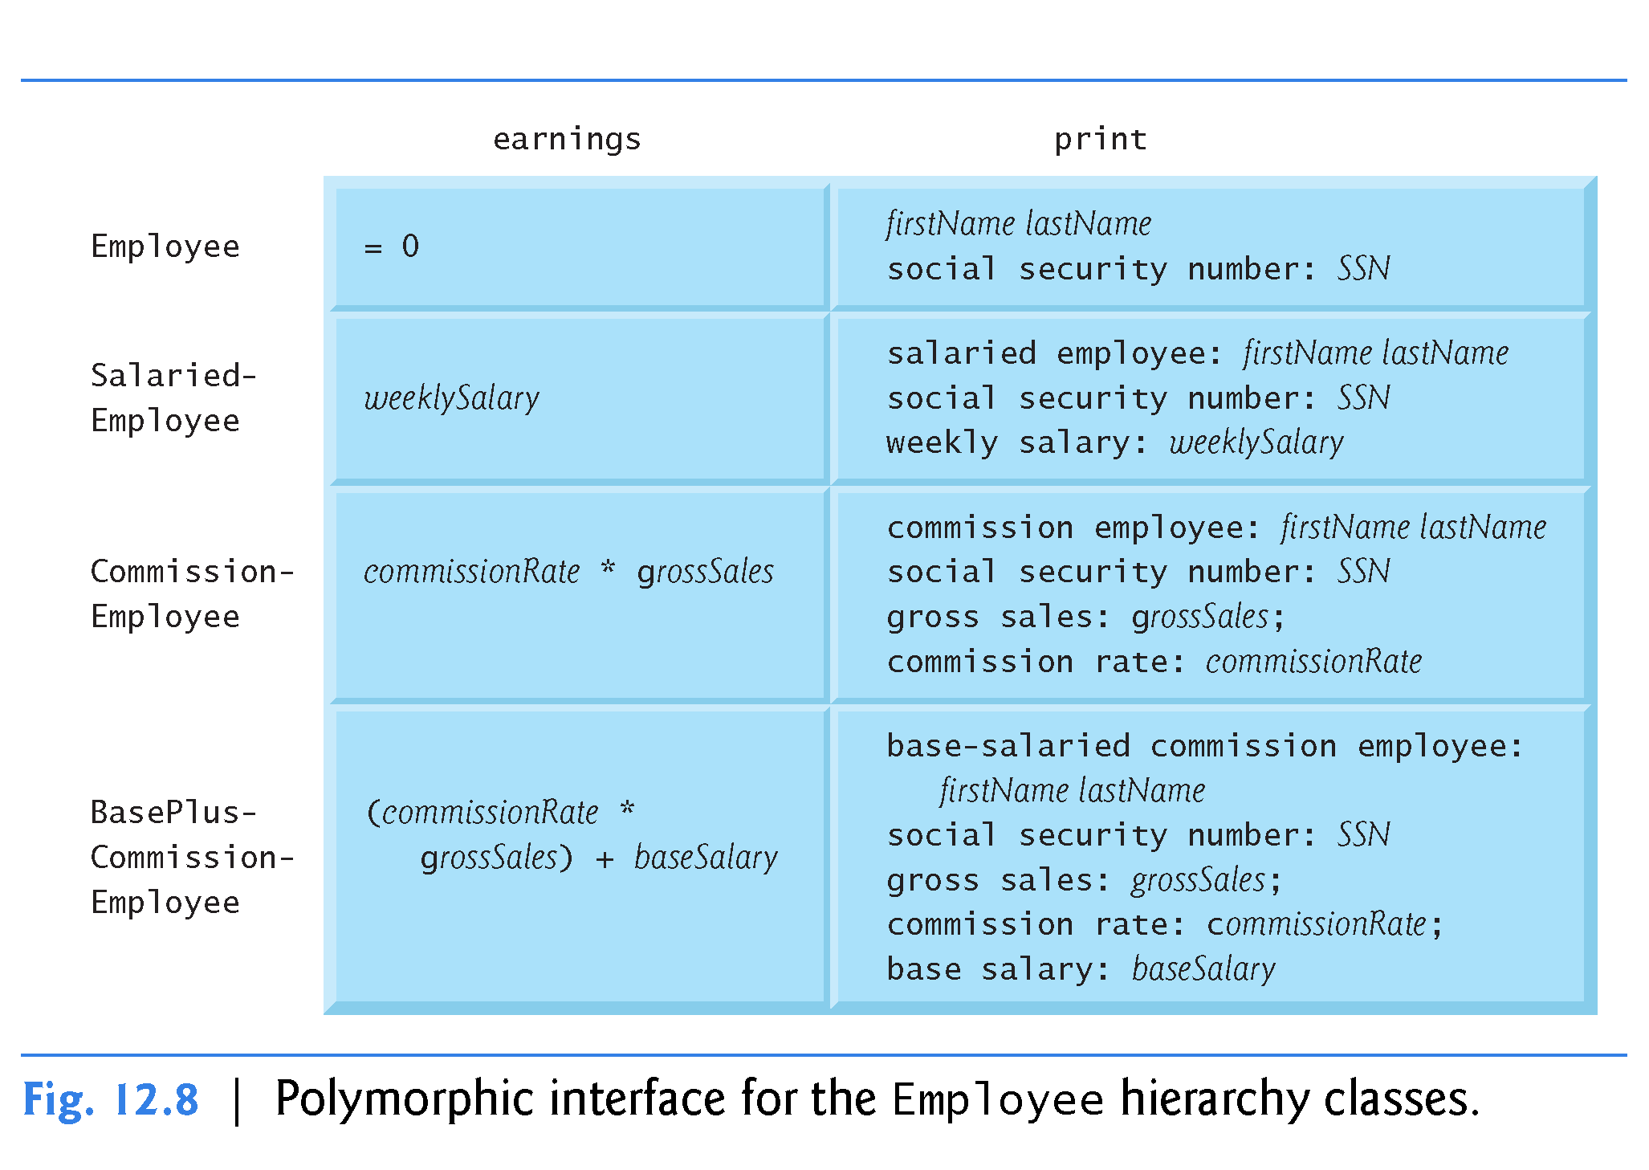

Slide 73
12.6.1 Creating Abstract Base Class Employee (cont.)
Employee Class Declaration
Let’s consider class Employee’s header (Fig. 12.9).
virtual destructor (line 13)
pure virtual function earnings (line 25)
virtual function print (line 26).

Slide 74
12.6.1 Creating Abstract Base Class Employee (cont.)
Employee Class Member-Function Definitions
Figure 12.10 contains the member-function definitions for class Employee.
No implementation is provided for pure virtual function earnings.

Slide 75
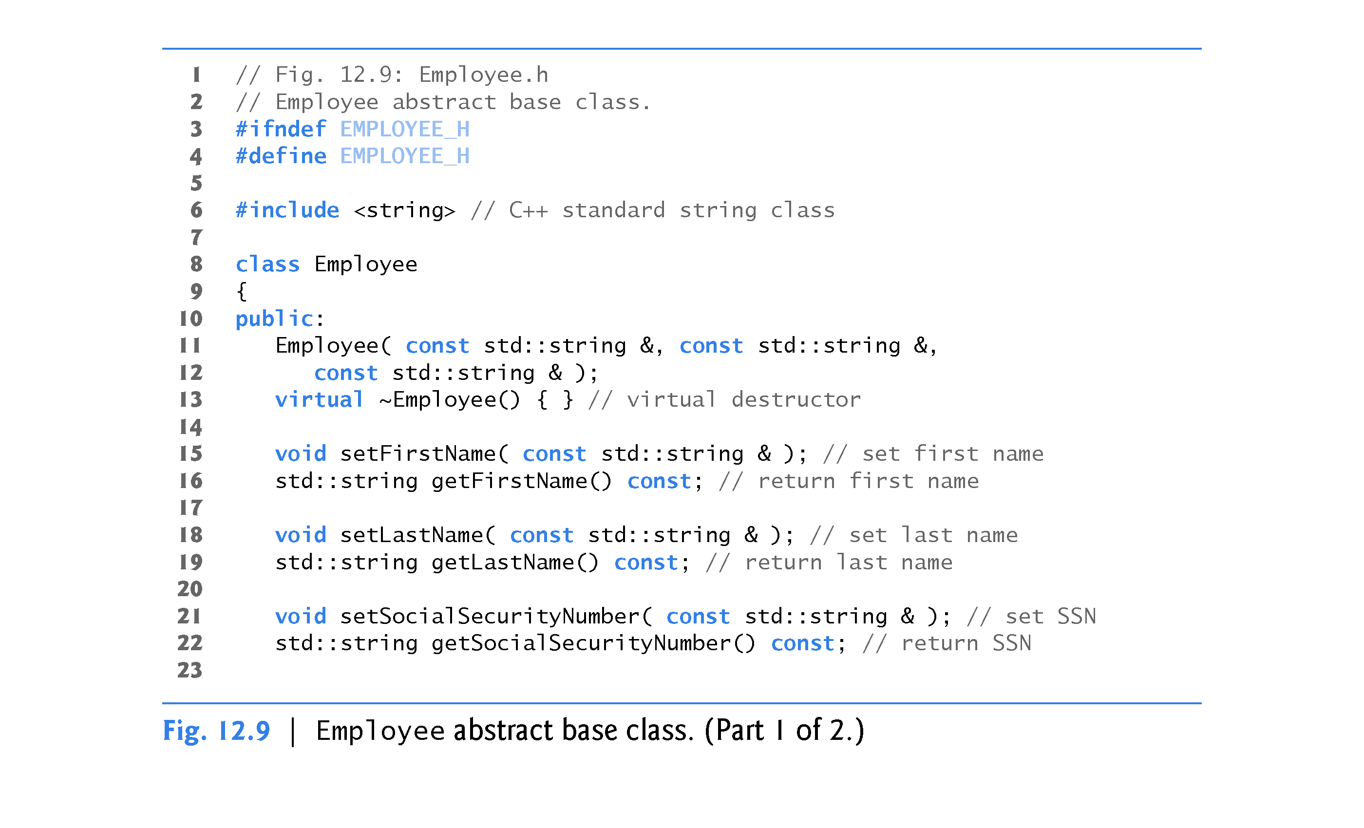

Slide 76
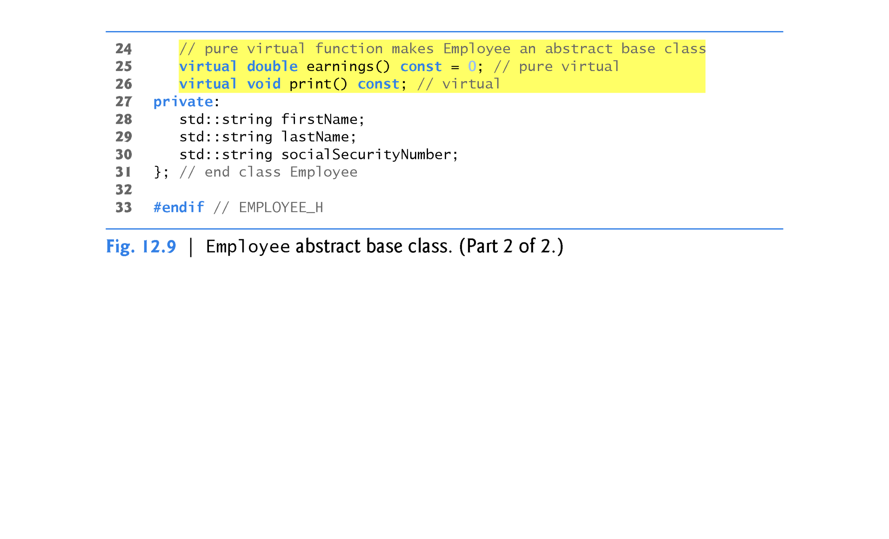
Function earnings is a pure virtual function (no implementation in the base class). Function earnings must be overridden in a derived class to create a concrete class.
Function print is a virtual function but NOT a pure virtual function (it is implemented in the base class). Function print can be (and will be) overridden in derived classes to provide object-specific functionality.

Slide 77
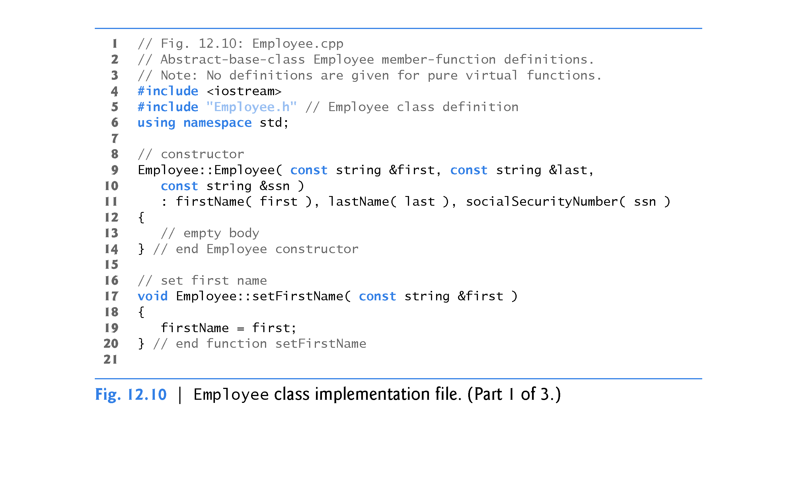

Slide 78
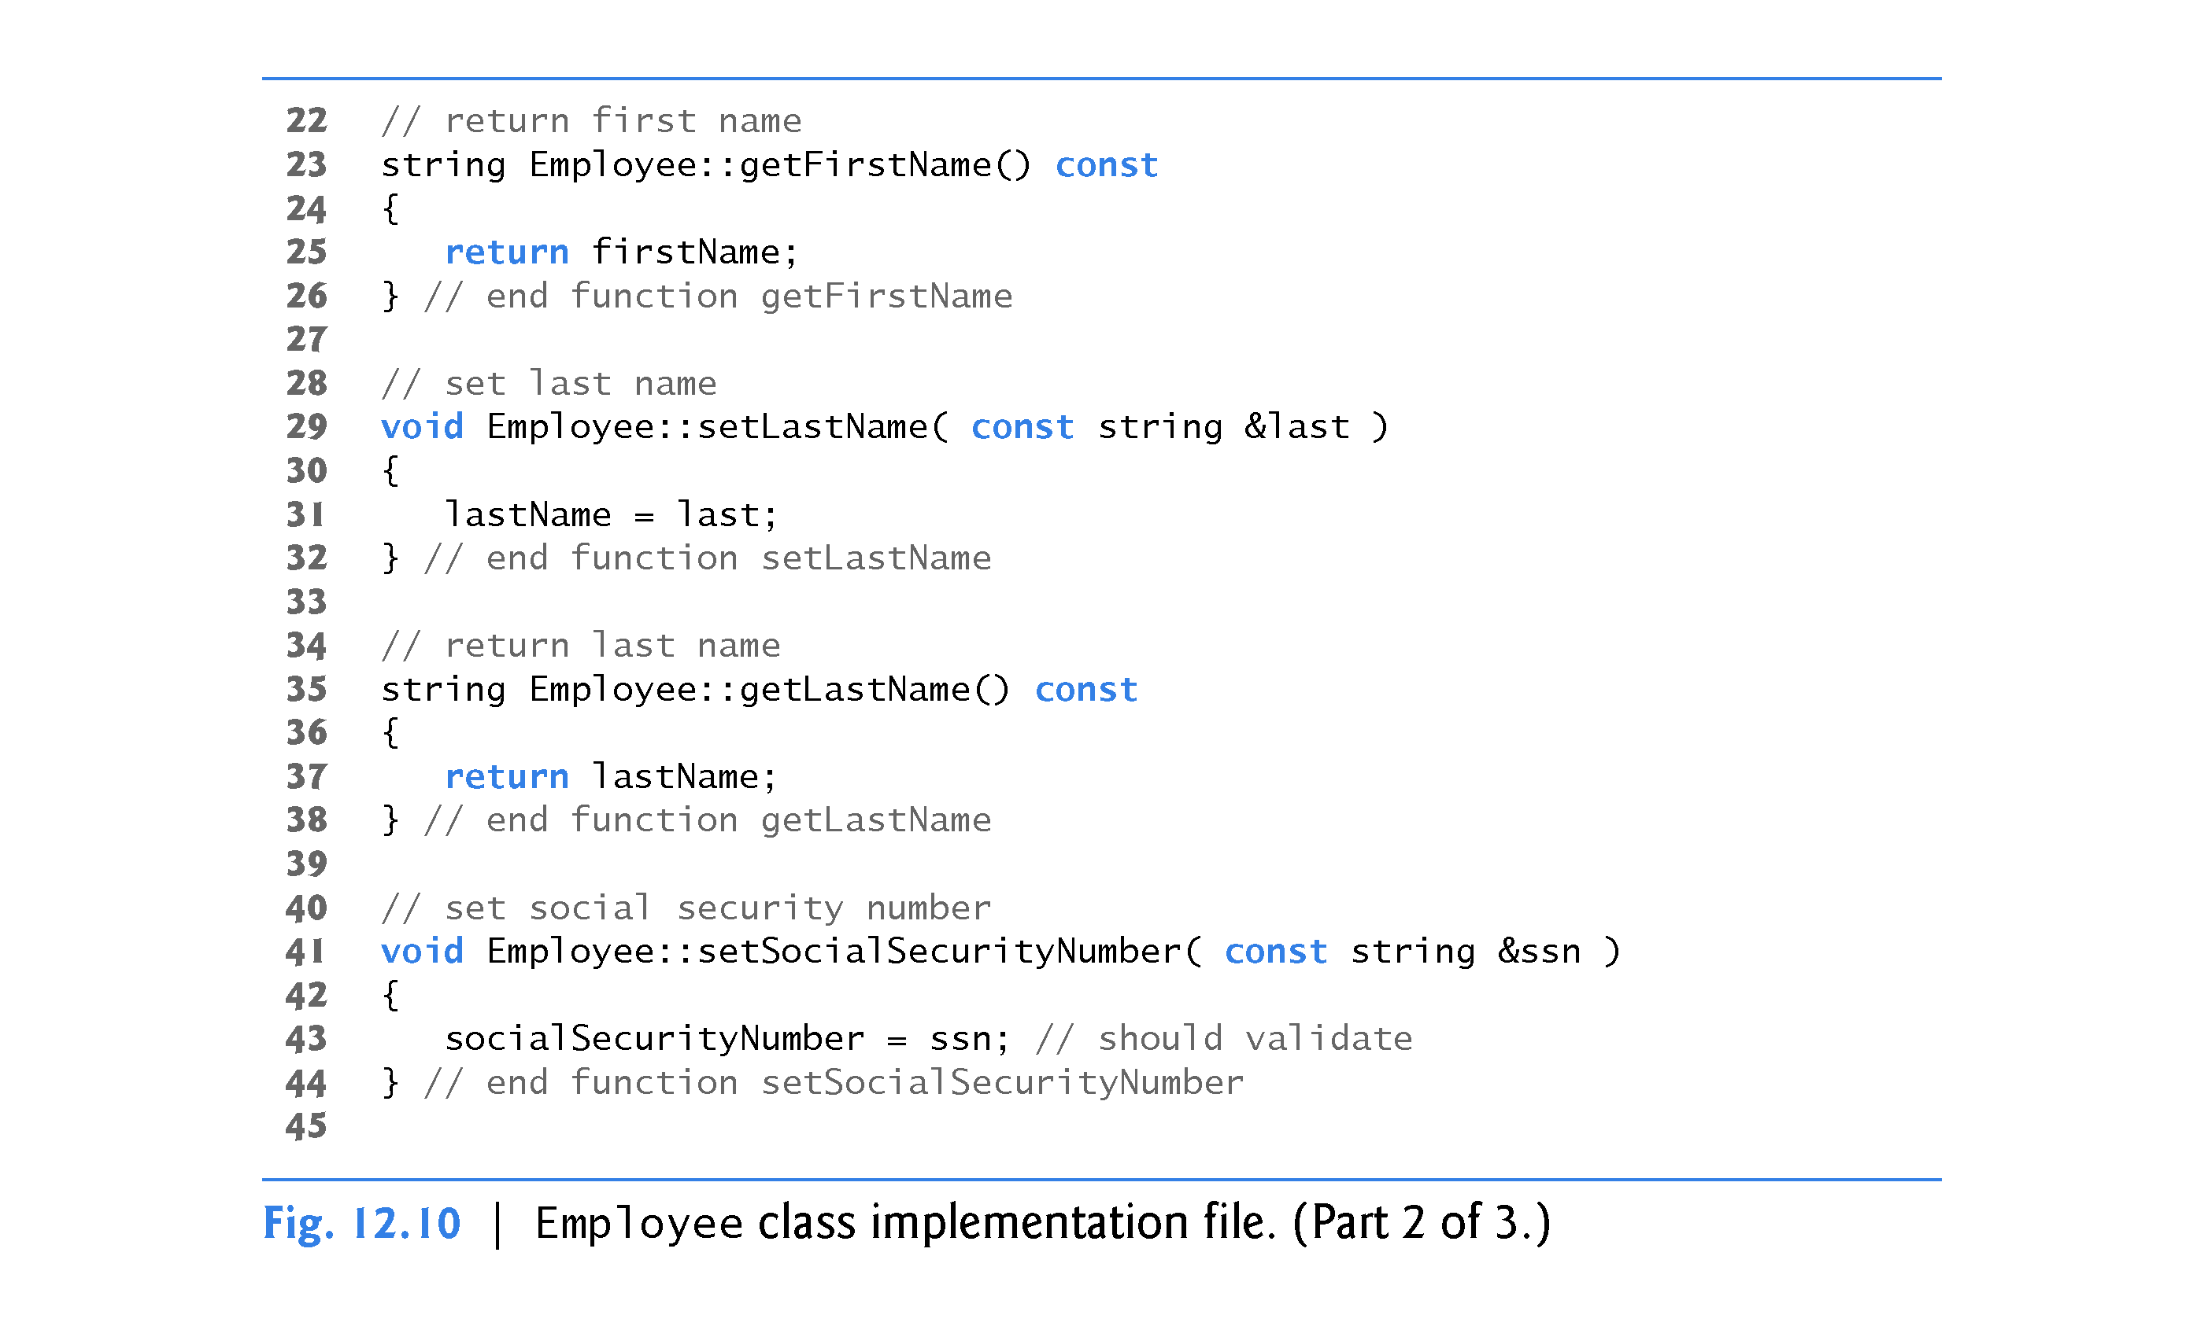

Slide 79
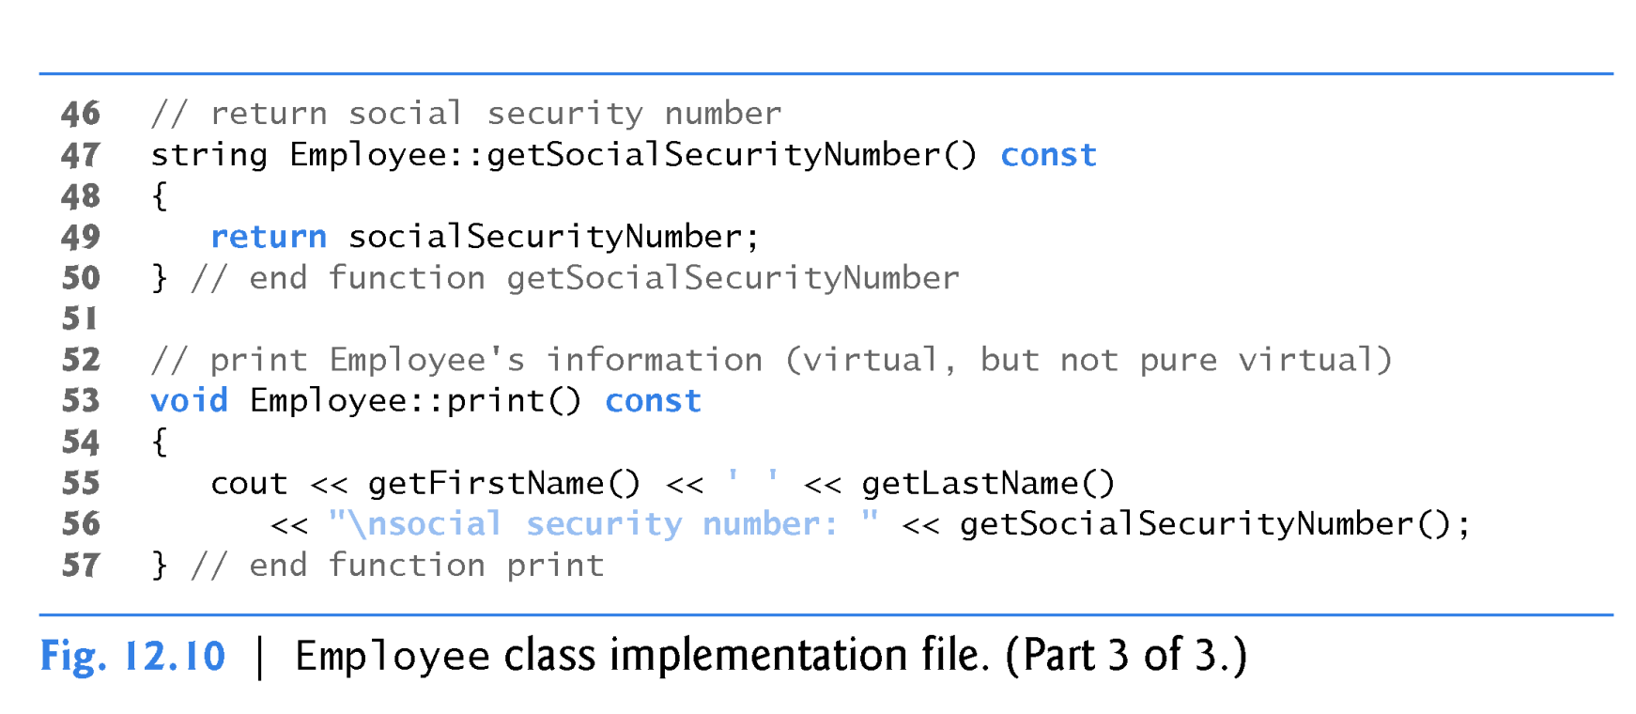

Slide 80
12.6.2 Creating Concrete Derived Class SalariedEmployee
Class SalariedEmployee (Figs. 12.11–12.12)

Slide 81
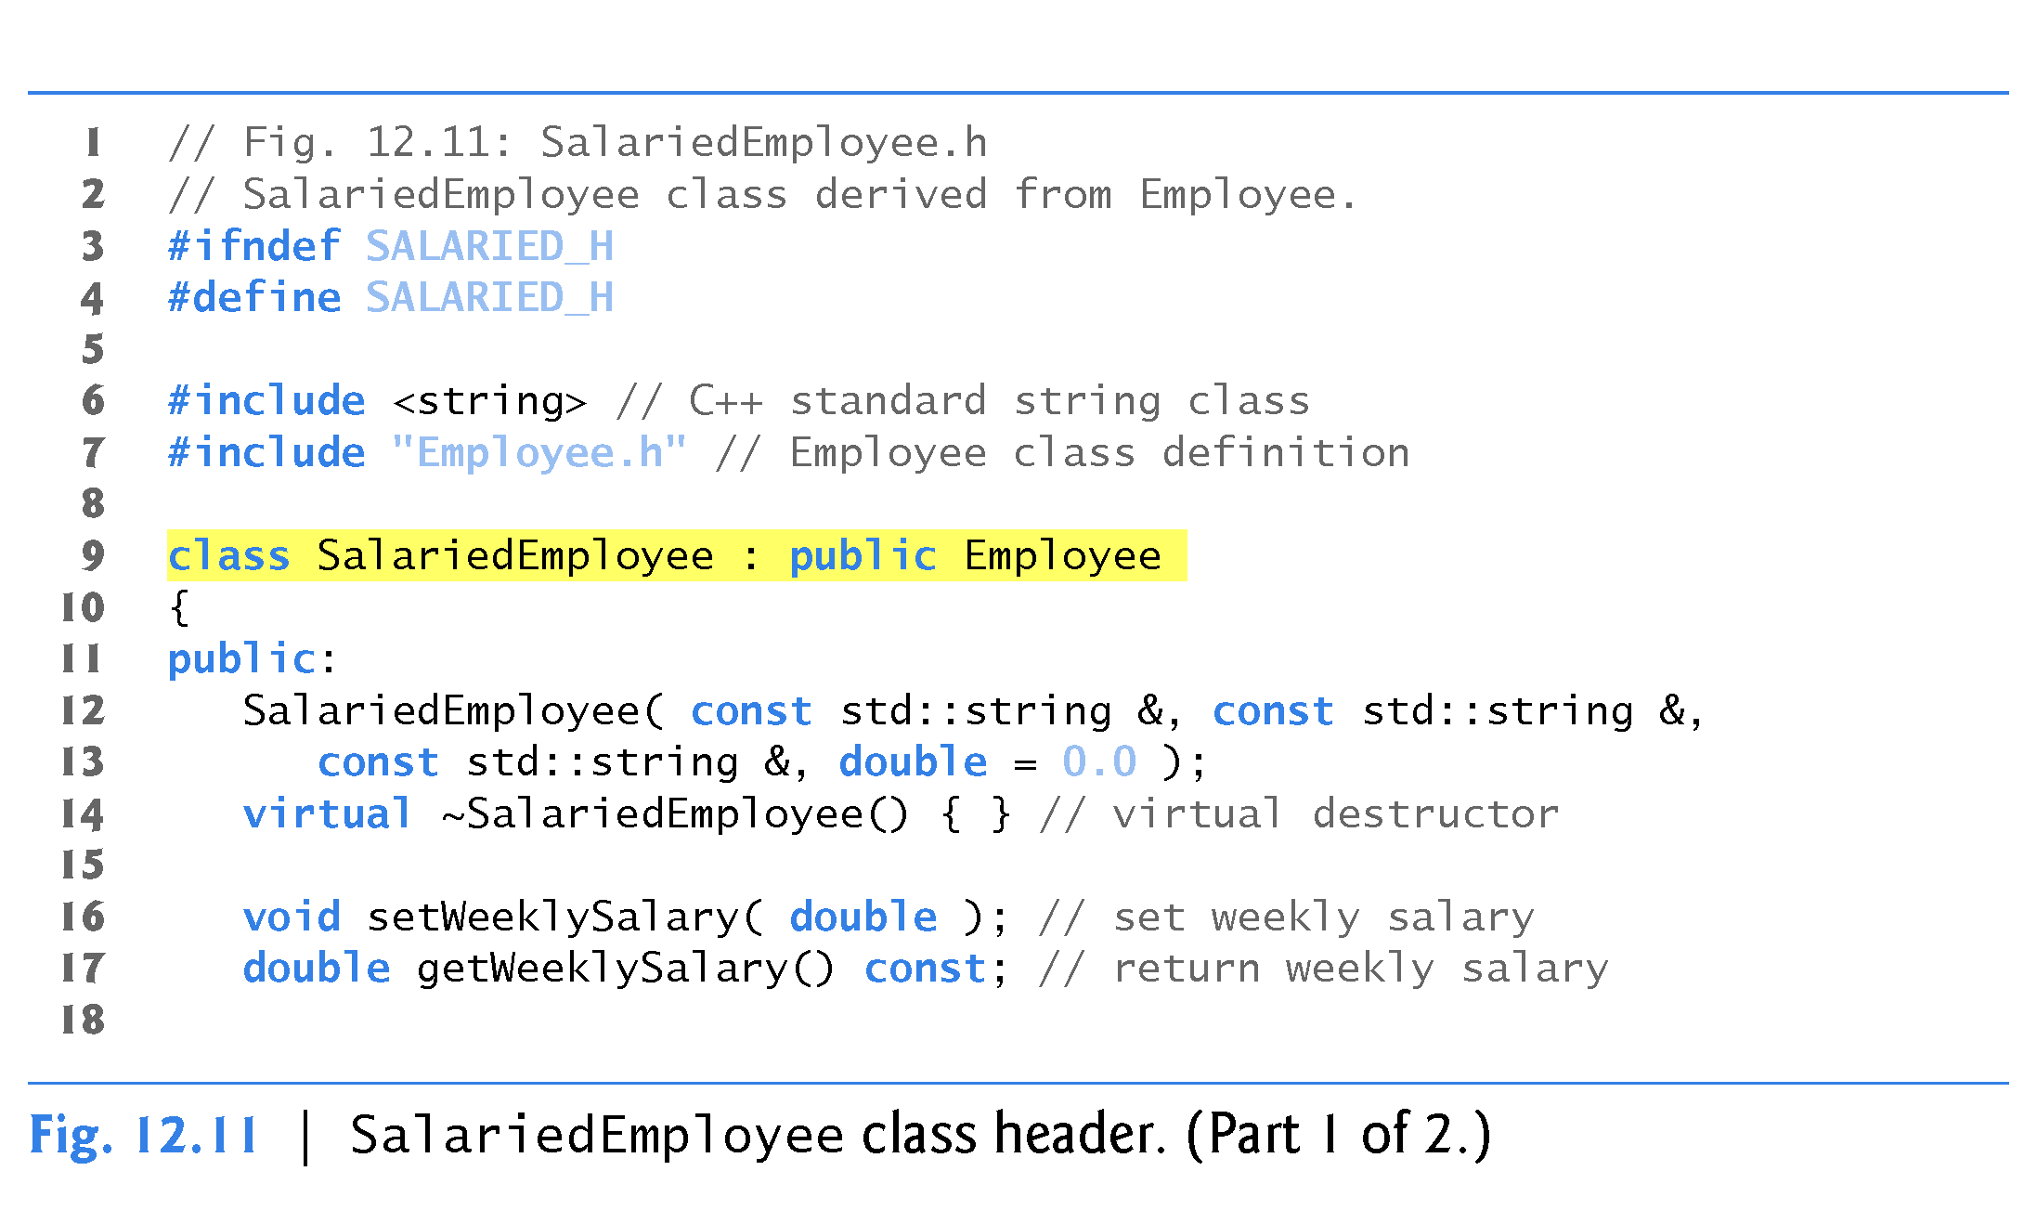
virtual keyword in destructor is redundant but documents it as a virtual destructor

Slide 82
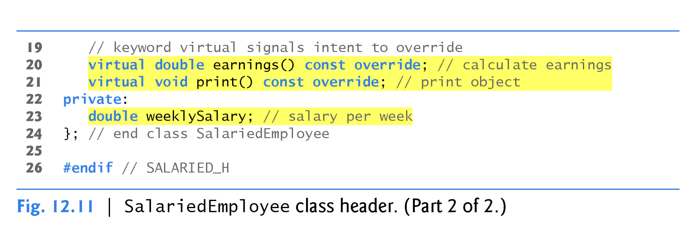
virtual keyword is redundant helps document the fact the function is a virtual function being overridden.
If there was no intention to override the functions then no prototype would be required in the derived class declaration. The derived class would use the base class version of the inherited function.

Slide 83
12.6.2 Creating Concrete Derived Class SalariedEmployee (cont.)
If we did not define earnings, class SalariedEmployee would be an abstract class.
In class SalariedEmployee’s header, we declared member functions earnings and print as virtual
This is redundant but it helps us remember these are virtual functions!
We defined them as virtual in base class Employee, so they remain virtual functions throughout the class hierarchy.

Slide 84
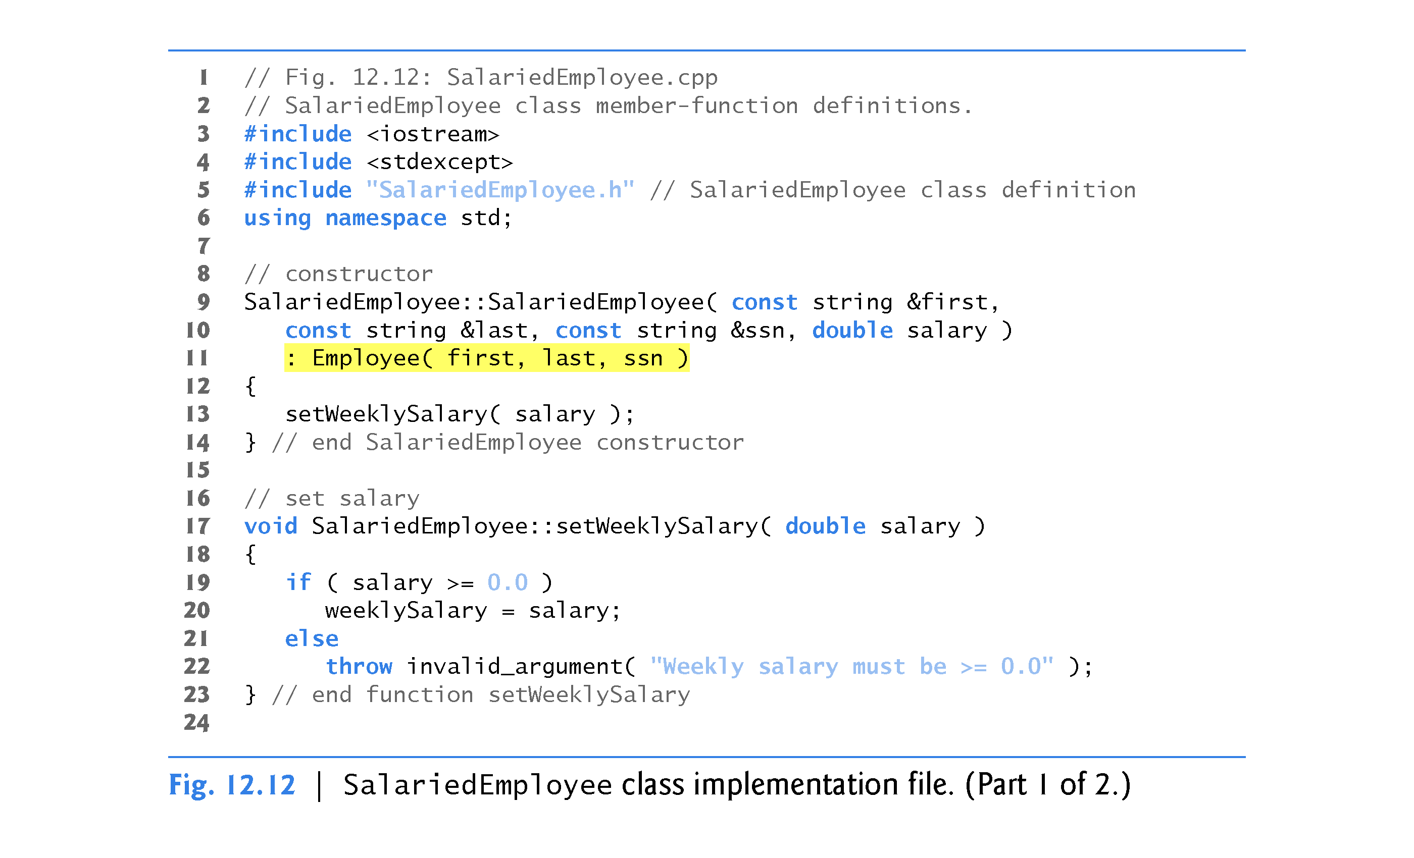

Slide 85
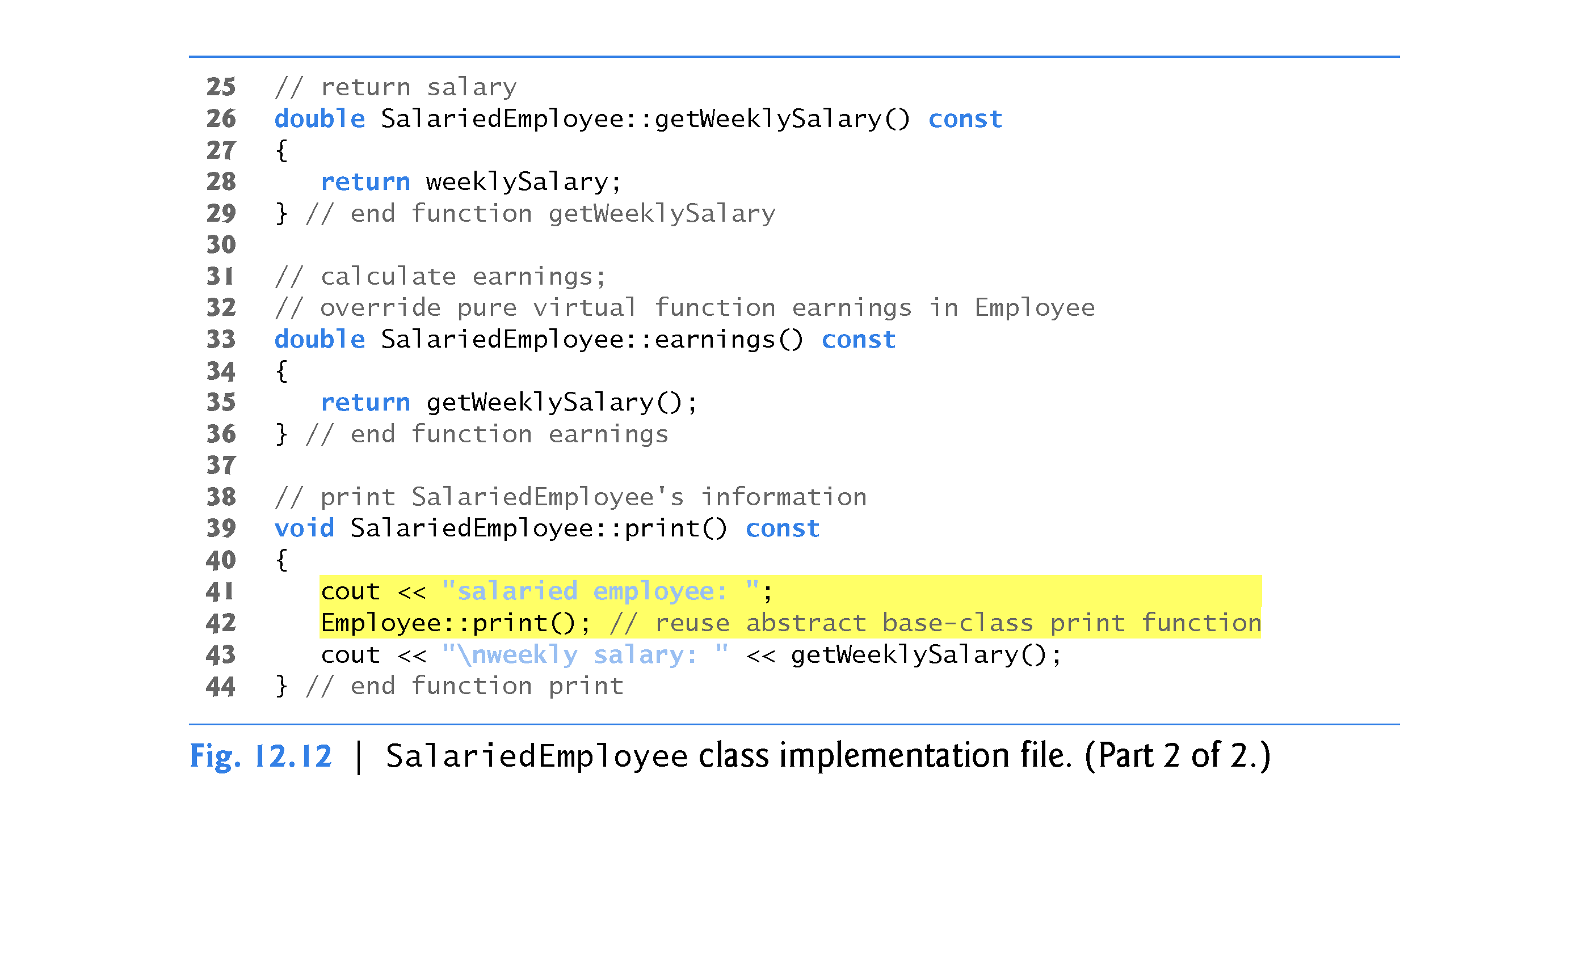

Slide 86
12.6.2 Creating Concrete Derived Class SalariedEmployee (cont.)
Function print of class SalariedEmployee (lines 39–44 of Fig. 12.12) overrides Employee function print.
If class SalariedEmployee did not override print, SalariedEmployee would inherit the Employee version of print.

Slide 87
12.6.3 Creating Concrete Derived Class CommissionEmployee

Slide 88
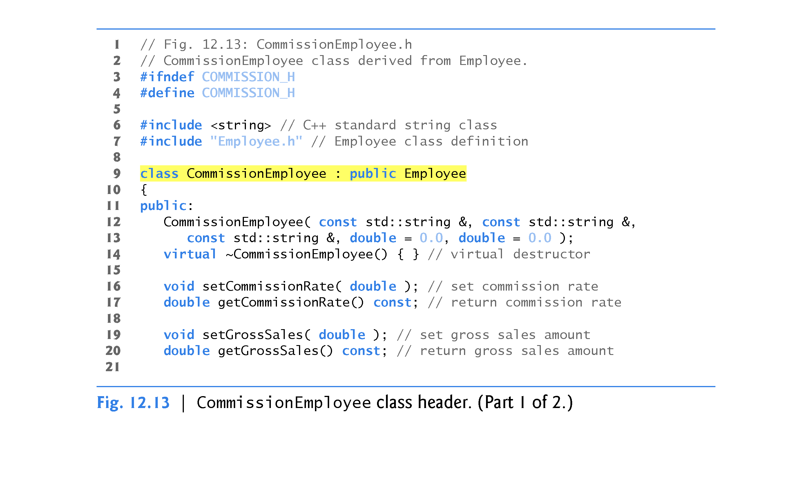

Slide 89
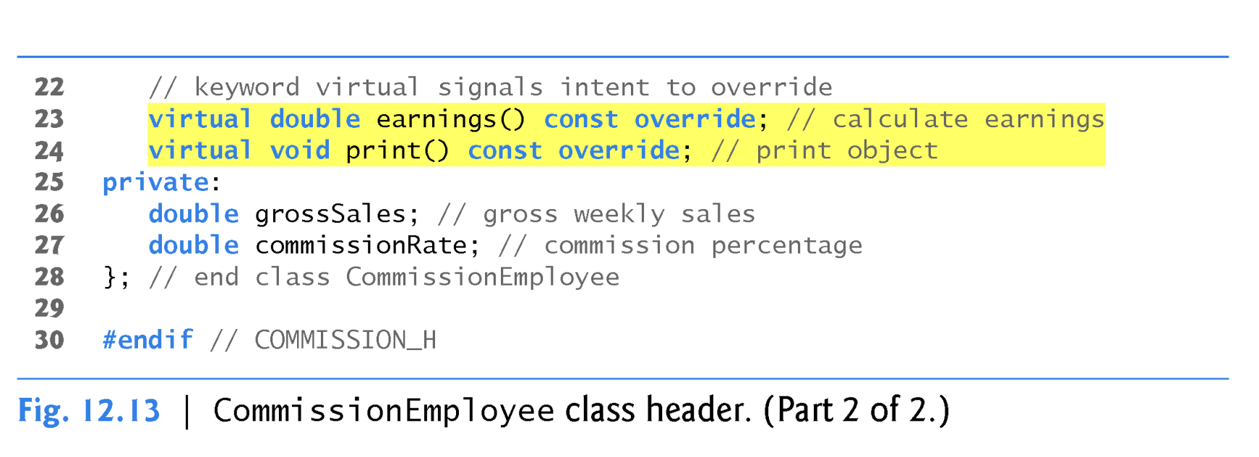

Slide 90
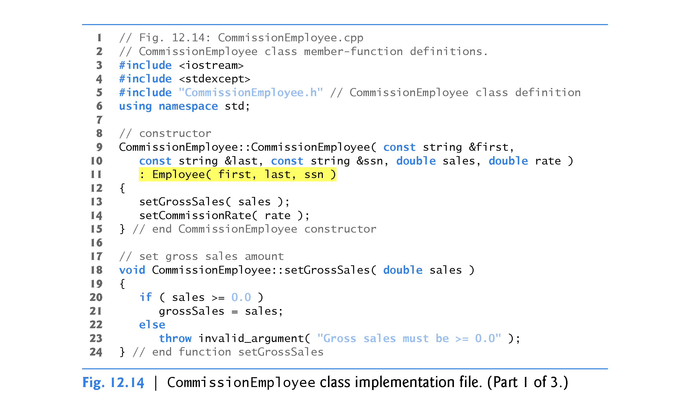

Slide 91
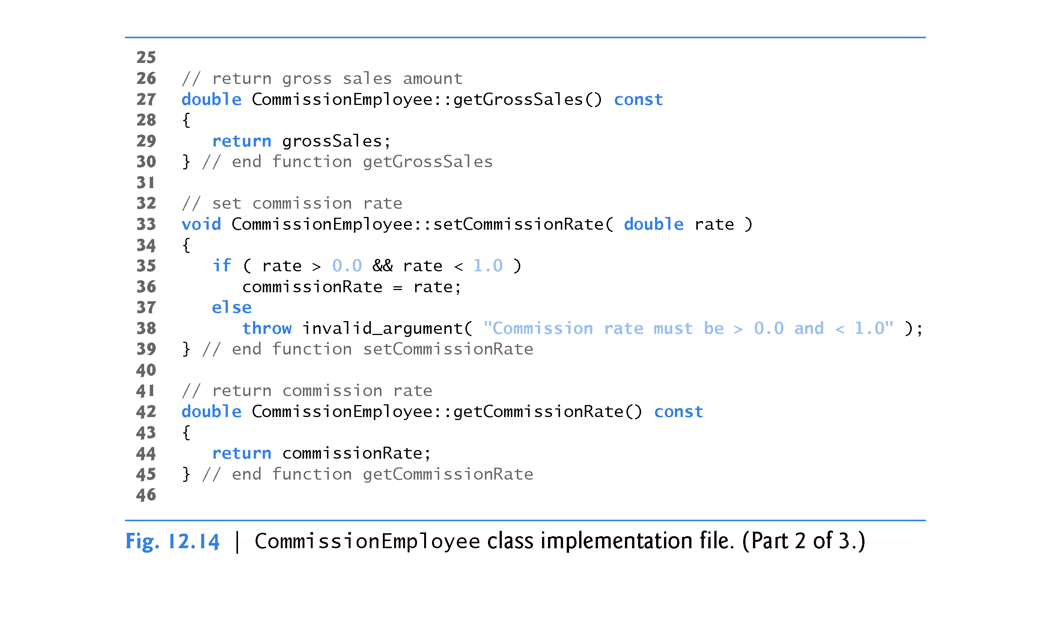

Slide 92


Slide 93
12.6.4 Creating Indirect Concrete Derived Class BasePlusCommissionEmployee

Slide 94


Slide 95


Slide 96


Slide 97


Slide 98


Slide 99
12.6.5 Demonstrating Polymorphic Processing
To test our Employee hierarchy, the program is Fig. 12.17
Each member-function invocation in lines 32–37 is an example of static binding—at compile time, because we are using name handles (not pointers or references that could be set at execution time), the compiler can identify each object’s type to determine which print and earnings functions are called.
Remember polymorphism requires the use of:
pointers or references
virtual functions
dynamic binding (run time binding).

Slide 100


Slide 101


Slide 102

vector of constant pointer to Employee

Slide 103


Slide 104


Slide 105


Slide 106


Slide 107
12.6.5 Demonstrating Polymorphic Processing (cont.)
Lines 54–55 traverse vector employees and invoke function virtualViaPointer (lines 67–71) for each element in employees.
Function virtualViaPointer receives in parameter baseClassPtr (of type const Employee * const) the address stored in an employees element.
Each call to virtualViaPointer uses baseClassPtr to invoke virtual functions print (line 69) and earnings (line 70).
Note that function virtualViaPointer does not contain any SalariedEmployee, CommissionEmployee or BasePlusCommissionEmployee type information.
The function knows only about base-class type Employee.
The output illustrates that the appropriate functions for each class are indeed invoked and that each object’s proper information is displayed.

Slide 108
12.6.5 Demonstrating Polymorphic Processing (cont.)
Each call to virtualViaReference invokes virtual functions print (line 77) and earnings (line 78) via baseClassRef to demonstrate that polymorphic processing occurs with base-class references as well.
Each virtual-function invocation calls the function on the object to which baseClassRef refers at runtime.
This is another example of dynamic binding.
The output produced using base-class references is identical to the output produced using base-class pointers.

Slide 109


Slide 110


Slide 111


Slide 112
12.8 Case Study: Payroll System Using Polymorphism and Runtime Type Information with Downcasting, dynamic_cast, typeid and type_info
Recall from the problem statement at the beginning of Section 12.6 that, for the current pay period, our fictitious company has decided to reward BasePlusCommissionEmployees by adding 10 percent to their base salaries.
When processing Employee objects polymorphically in Section 12.6.5, we did not need to worry about the “specifics.”
To adjust the base salaries of BasePlusCommissionEmployees, we have to determine the specific type of each Employee object at execution time, then act appropriately.

Slide 113
12.8 Case Study: Payroll System Using Polymorphism and Runtime Type Information with Downcasting, dynamic_cast, typeid and type_info (cont.)
This section demonstrates the powerful capabilities of runtime type information (RTTI) and dynamic casting, which enable a program to determine an object’s type at execution time and act on that object accordingly.
Figure 12.19 uses the Employee hierarchy developed in Section 12.6 and increases by 10 percent the base salary of each BasePlusCommissionEmployee.

Slide 114


Slide 115

Note use of new keyword! This is dynamically allocated memory.

Slide 116


Slide 117


Slide 118
12.8 Case Study: Payroll System Using Polymorphism and Runtime Type Information with Downcasting, dynamic_cast, typeid and type_info (cont.)
Since we process the Employees polymorphically, we cannot (with the techniques you’ve learned so far) be certain as to which type of Employee is being manipulated at any given time.
BasePlusCommissionEmployee employees must be identified when we encounter them so they can receive the 10 percent salary increase.
To accomplish this, we use operator dynamic_cast (line 39) to determine whether the current Employee’s type is BasePlusCommissionEmployee.
This is the downcast operation we referred to in Section 12.3.3.
Lines 38–39 dynamically downcast employeePtr from type Employee * to type BasePlusCommissionEmployee *.

Slide 119
12.8 Case Study: Payroll System Using Polymorphism and Runtime Type Information with Downcasting, dynamic_cast, typeid and type_info (cont.)
If employeePtr element points to an object that is-a BasePlusCommissionEmployee object, then that object’s address is assigned to derived-class pointer derivedPtr; otherwise, nullptr is assigned to derivedPtr.
Note that dynamic_cast rather than static_cast is required here to perform type checking on the underlying object—a static_cast would simply cast the Employee * to a BasePlusCommissionEmployee * regardless of the underlying object’s type.

Slide 120
12.8 Case Study: Payroll System Using Polymorphism and Runtime Type Information with Downcasting, dynamic_cast, typeid and type_info (cont.)
With a static_cast, the program would attempt to increase every Employee’s base salary, resulting in undefined behavior for each object that is not a BasePlusCommissionEmployee.
If the value returned by the dynamic_cast operator in lines 38–39 is not nullptr, the object is the correct type, and the if statement (lines 42–49) performs the special processing required for the BasePlusCommissionEmployee object.

Slide 121
12.8 Case Study: Payroll System Using Polymorphism and Runtime Type Information with Downcasting, dynamic_cast, typeid and type_info (cont.)
Operator typeid (line 59) returns a reference to an object of class type_info that contains the information about the type of its operand, including the name of that type.
When invoked, type_info member function name (line 59) returns a pointer-based string containing the typeid argument’s type name (e.g., "class BasePlusCommissionEmployee").
To use typeid, the program must include header <typeinfo> (line 8).

Slide 122


